Slide 1


GreenCircle Certified
Database Project
Wireframes and User Stories

Slide 2
Project Timeline Updates
Tasks | Timeline
Week Start Date | 2/3 | 2/10 | 2/17 | 2/24 | 3/3 | 3/10 | 3/17 | 3/24 | 3/31 | 4/7 | 4/14 | 4/21 | 4/28 | 5/5 | 5/12 | 5/19 | 5/26 | 6/2 | 6/9 | 6/16 | 6/23 | 6/30 | 7/7 | 7/14
Week End Date | 2/7 | 2/14 | 2/21 | 2/28 | 3/7 | 3/14 | 3/21 | 3/28 | 4/4 | 4/11 | 4/18 | 4/25 | 5/2 | 5/9 | 5/16 | 5/23 | 5/30 | 6/6 | 6/13 | 6/20 | 6/27 | 7/4 | 7/11 | 7/18
Requirements & Analysis
Architecture / Environment Setup
Database Expansion
API Development
Front-end Design
Front-end Development
Testing and Validation
Deployment & Configuration
Documentation
Updates pending
Milestones:
5/9 – Wireframes & Requirement complete
6/13 – Development Complete
6/27 – Testing Complete
7/11 – Go live
Coordination:
6/16 – 6/27 : Business Acceptance Testing, Defect Resolution
6/16 – 6/27 : API Testing with Amazon
6/30 – 7/11 : Deployment Activities

Slide 3

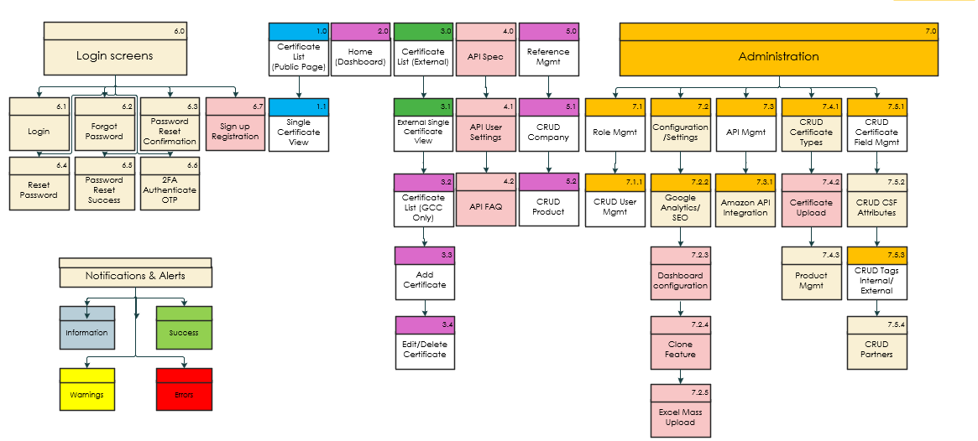
GreenCircle Certified Database Site Map
Updates pending
Notes:
CRUD: [Create, Read, Update, Delete] – Wireframes include the details of the screens.
Notifications & Alerts: Color-coded: Green for success, Red for errors, Yellow for warnings, Blue/gray for info)
Sign-up Registration will be included but hidden and disabled for all users except the admin.
Assumptions:
Certificate List 1.0 is a different page than Certificates 3.0.
Admin will have the ability to Add, Edit or Delete a Certificate, Company, Products, Users, Certificate Type, Product Types and Tags.
Notes:
Comments:
S2:
See comment on page 46 may need these pages to edit/delete Product Name or Company Name records unless you can find another way
How do you add a new field. Not represented anywhere.
Remove (Roles) from site map.
Is there an API page – or is that all backend?
7.1.3 – see comments in section
Are you accounting for non-phase 1 on purpose? No this was missed when updating the documents.
Grayed Items: Some were intentionally removing.
3.3 – This would be clients and partners
There needs to be interface for the Analyst to be able to add and edit new Product (and associate product category/type to it) and Company. Current DB has this happening in the Cert upload interface and separate pages.

Slide 4

User Stories

Slide 5
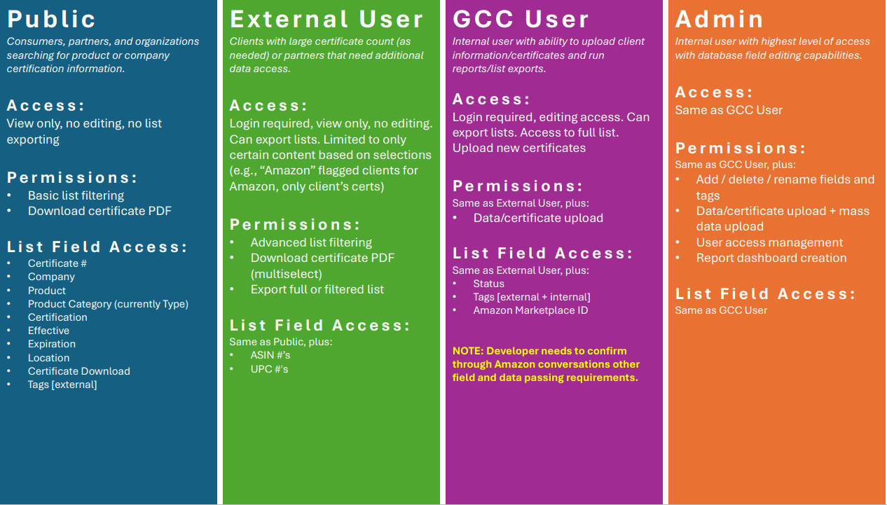
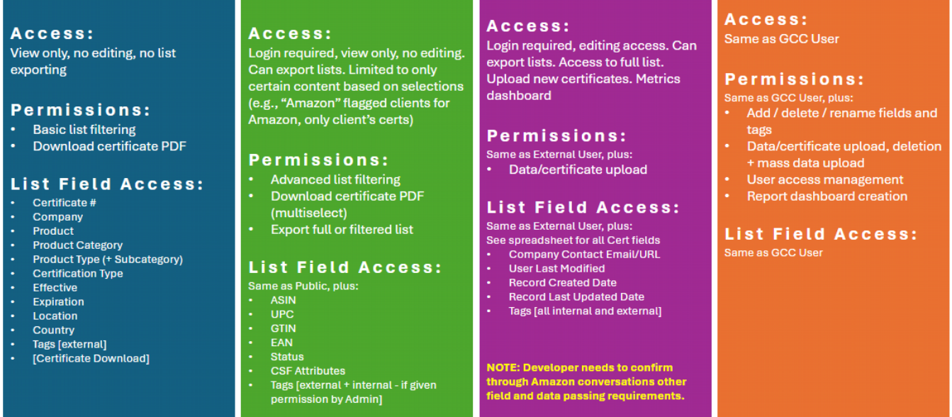
GCC: User Roles
Notes:
S3:
Replace image with updated Role information.
Add: Public: Product Type (+Subcategory)
Add: Public: Country
Add: External: GTIN, EAN, Status, CSF Attributes, Tags [external + internal – if given permission by Admin]
Add: GCC User: Metrics dashboard
Add: Admin: deletion
See spreadsheet for all Cert fields, Company Contact Email /URL, User Last Modified, Record Created Date, Record Last Updated Date, Tags [all internal and external]

Slide 6
User Stories – Public User
Access & Visibility
As a public user, I want to browse publicly available active certifications so that I can verify product compliance.
As a public user, I want to access certifications without needing to log in so that I can quickly find information.
As a public user, I want to view only non-confidential certifications so that I do not access restricted data.
Search & Filtering
As a public user, I want to search for certifications by certificate number, certificate type, company, country or product so that I can verify compliance.
As a public user, I want to filter certifications by product, product type / category, and product subcategory so that I can narrow my search.
As a public user, I want to see the most recently issued certifications and those with upcoming expiration dates.
Viewing & Downloading Certifications
As a public user, I want to view details of a certification so that I can verify product compliance.
As a public user, I want to view and download single certifications so that I can reference them offline.
Notes:
S7: comments: user stories updated.

Slide 7
User Stories – Public User
Tagging & Classification
As a public user, I want to see tags assigned to certifications so that I can understand additional certification classifications.
As a public user, I want to search for certifications by tag so that I can find related certificates.
Data Access & Security
As a public user, I want to access only publicly available information so that confidential data remains protected.
Notes:
updated

Slide 8
User Stories – External User (Client)
Access & Visibility
As an external user, I want to log in securely so that I can access my company's certification data.
As an external user, I want to see all certifications related to my company so that I can track compliance.
As an external user, I want to ensure that I cannot see certifications from other companies so that my access is restricted to my organization.
As an external user, I want my permissions to be pre-defined by an admin so that I only access the relevant data.
As an external user, I want to be able to filter my certifications based on status (active, expired, pending) so that I can quickly find relevant information.
Search & Filtering
As an external user, I want to search for certifications within my company so that I can locate specific records.
As an external user, I want to filter certifications by type, category, and subcategory so that I can narrow down the results.
As an external user, I want to sort certifications by expiration date so that I can prioritize renewals.
As an external user, I want to search certifications by product name so that I can verify specific items.
As an external user, I want to filter by location, tags, and other available filter options based on their intended search purpose.
As an external user, I want to export my company's certification data into Excel so that I can use it for reporting and documentation. purposes.
Notes:
GCC Comments:
We will have 2 types of External Users and I think you should break them out.
1. Customers (which you have accounted for here)
2. Partners (where they will have access across companies for products that are part of their program only – for example Amazon CPF clients/certs)
This helped to answer one of my questions!

Slide 9
User Stories – External User (Client)
Viewing & Downloading Certifications
As an external user, I want to view details of each certification so that I can verify product compliance.
As an external user, I want to download certificates in multi-select format so that I can share them with my stakeholders.
As an external user, I want to check the expiration date of a certification so that I can ensure timely renewals.
Tagging & Classification
As an external user, I want to see assigned tags on certifications so that I can categorize data effectively.
As an external user, I want to filter certifications based on assigned tags so that I can group relevant products together.
As an external user, I want to view which products are associated with a specific certification so that I can understand product compliance.
Data Access & Security
As an external user, I want my access restricted to only my company's data so that I do not see competitors' certifications.
As an external user, I want to log out securely so that I can prevent unauthorized access to my account.
As an external user, I want my account to be managed by an admin so that permissions are properly controlled.
Notes:
- Deleted: As an external user, I want to see the issuing agency of a certification so that I can verify its credibility.
It’s unlikely we would create unique tags for a particular client’s purpose only.
Deleted: As an external user, I want to request additional tags for my company's certifications so that I can enhance organization.
Maybe for partners but should not need API for clients.
Deleted: As an external user, I want to request additional access from an admin if needed so that I can view more relevant certifications and/or API configuration.

Slide 10
User Stories – External User (Partner)
Access & Visibility
As an external user, I want to log in securely so that I can access my program's certification data.
As an external user, I want to see all certifications related to my program so that I can track compliance.
As an external user, I want to ensure that I cannot see certifications from other companies or programs so that my access is restricted to my program.
As an external user, I want my permissions to be pre-defined by an admin so that I only access the relevant data.
As an external user, I want to be able to filter my certifications based on status (active, expired, pending) so that I can quickly find relevant information.
Search & Filtering
As an external user, I want to search for certifications within my program so that I can locate specific records.
As an external user, I want to filter certifications by type, category, and subcategory so that I can narrow down the results.
As an external user, I want to search certifications by product name so that I can verify specific items.
As an external user, I want to filter by location, tags, and other available filter options based on their intended search purpose.
As an external user, I want to export my program certification data into Excel so that I can use it for reporting and documentation purposes.
Notes:
GCC Comments:
We will have 2 types of External Users and I think you should break them out.
1. Customers (which you have accounted for here)
2. Partners (where they will have access across companies for products that are part of their program only – for example Amazon CPF clients/certs)
This helped to answer one of my questions!

Slide 11
User Stories – External User (Partner)
Viewing & Downloading Certifications
As an external user, I want to view details of each certification so that I can verify product compliance.
As an external user, I want to download certificates in multi-select format so that I can share them with my stakeholders.
As an external user, I want to check the expiration date of a certification so that I can validate certification period.
Tagging & Classification
As an external user, I want to see assigned tags on certifications so that I can categorize data effectively.
As an external user, I want to filter certifications based on assigned tags so that I can group relevant products together.
As an external user, I want to view which products are associated with a specific certification so that I can understand product compliance.
Data Access & Security
As an external user, I want my access restricted to only my program’s data so that I do not see competitors’ or restricted certifications.
As an external user, I want to log out securely so that I can prevent unauthorized access to my account.
As an external user, I want my account to be managed by an admin so that permissions are properly controlled.
As an external user, I want to request additional access from an admin if needed so that I can view more relevant certifications and/or API configuration.
Notes:
- Deleted: As an external user, I want to see the issuing agency of a certification so that I can verify its credibility.
It’s unlikely we would create unique tags for a particular client’s purpose only.
Deleted: As an external user, I want to request additional tags for my company's certifications so that I can enhance organization.
Maybe for partners but should not need API for clients.
Deleted: As an external user, I want to request additional access from an admin if needed so that I can view more relevant certifications and/or API configuration.

Slide 12
User Stories – GCC Analyst
Access & Visibility
As an analyst, I want to log in securely so that I can access certification data.
As an analyst, I want to see all certifications so that I can manage records effectively.
As an analyst, I want my access restricted to only my assigned role so that I do not see unauthorized data.
As an analyst, I want to view dashboard reports so that I can track data and trends.
Search & Filtering
As an analyst, I want to filter certifications by all fields so that I can generate reports and narrow by results based on my search needs.
As an analyst, I want to sort certifications by modification date so that I can easily find a recent certificate that may need additional edits.
Viewing & Downloading Certifications
As an analyst, I want to view detailed certification records so that I can ensure compliance accuracy.
As an analyst, I want to download certification data in bulk so that I can conduct offline analysis.
As an analyst, , I want to see the history of modifications for a certification so that I can track changes.
As an analyst, I want to download multiple certifications based on search criteria to view or save in bulk.
As an analyst, I want to be able to add and edit certificates, cert status, products, and companies.
Notes:
Deleted: As an analyst, I want to search for certifications across multiple companies so that I can analyse trends.
- They don’t use for this purpose today but it could be.

Slide 13
User Stories – GCC Analyst
Tagging & Classification
As an analyst, I want to assign tags to certifications so that I can classify them effectively.
As an analyst, I want to edit or remove assigned tags so that I can keep records up to date.
Data Access & Security
As an analyst, I want my access to be restricted based on admin settings so that I only see relevant data and don’t make unintended changes.
As an analyst, I want to track user activity logs so that I can review who made modifications to records.
Notes:
Deleted: As an analyst, I want to submit requests to modify certifications so that an admin can approve changes.

Slide 14
User Stories - Admin
Access & Visibility
As an admin, I want to manage user roles and permissions so that I can control access levels.
As an admin, I want to view all certifications across all companies so that I can oversee compliance.
As an admin, I want to create, edit, and delete user accounts so that I can manage system access.
Search & Filtering
As an admin, I want to search certifications across all companies so that I can manage records efficiently.
As an admin, I want to filter any of the certificate fields so that I can oversee compliance trends.
As an admin, I want to sort certifications by the last modified date so that I can track updates.
As an admin, I want to be able to set the certificate status (active, expired, pending).
Viewing & Downloading Certifications
As an admin, I want to view detailed certification records across the entire platform so that I can manage data integrity.
As an admin, I want to export all certification data so that I can generate system-wide reports.
As an admin, I want to track certification history and changes so that I can audit modifications.

Slide 15
User Stories - Admin
Tagging & Classification
As an admin, I want to create, edit, and remove tags so that I can organize certifications effectively.
As an admin, I want to standardize tags across the platform so that users have consistent classification options.
As an admin, I’m the only role that has the ability to edit product categories, product types and subcategories, certification types, CSF attributes.
As an admin, I have the ability to add new fields.
Data Access & Security
As an admin, I want to enforce multi-factor authentication so that system security is enhanced.
As an admin, I want to track user activity logs so that I can monitor system usage.
As an admin, I want the ability to add a new field to certificates.
As an admin, I want to restrict access to certain certifications so that only authorized users can view them.
As an admin, I want to integrate API connections with third-party platforms so that external vendors can securely access data.
As an admin, I want the ability to add, update or delete data for product types, certificate types, partners, CSF Attributes, etc. (TODO: list all CRUD fields.)
As an admin, I want the system back-end to manage what appears in the public database based on active status.
As an admin, I want the system back-end to handle certificate numbering with manual override option available if needed.

Slide 16
Login & Notification Screens

Slide 17
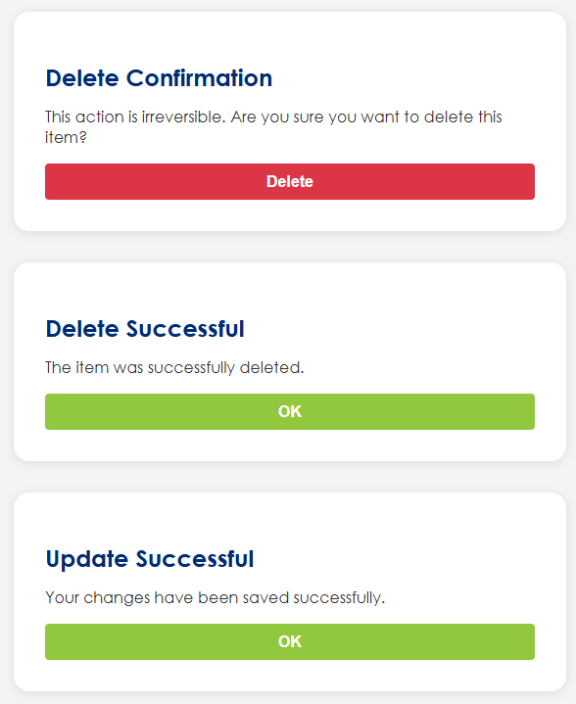
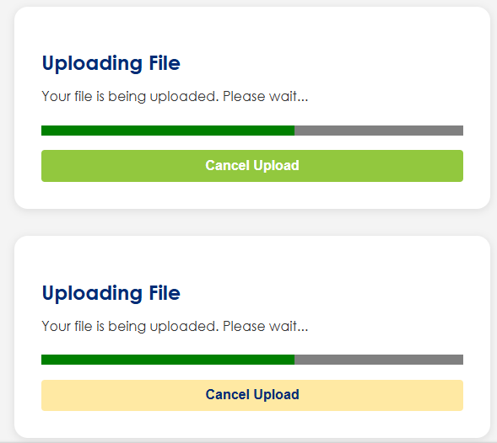
Notifications & Alerts
Notes:
Examples of notification and alerts.
We will need to identify all instances of where notifications and alerts need to occur.
Color-coded:
  Green for success
  Red for errors
  Yellow for warnings on toast messages.
  Blue/gray for info(navy blue)

Slide 18
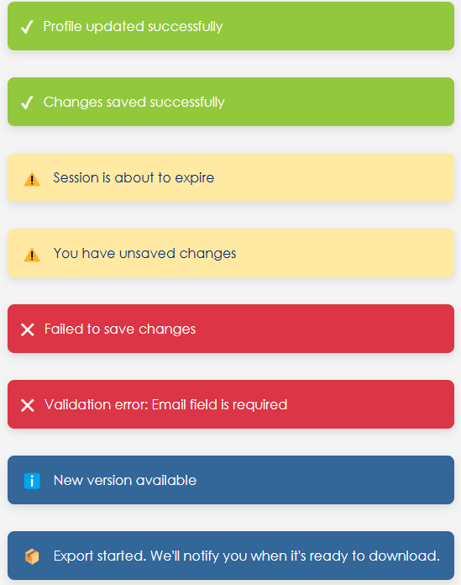
Notifications & Alerts
Notes:
Examples of notification and alerts.
We will need to identify all instances of where notifications and alerts need to occur.
Color-coded:
  Green for success
  Red for errors
  Yellow for warnings
  Blue/gray for info(navy blue)

Slide 19
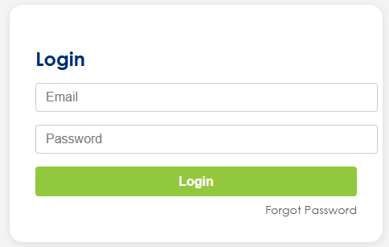
Wireframe Notes – 6.1 – Login
Login Screen
Username/Email and Password fields
Login button
"Forgot Password" link
Notes:
View Certificate: Could we have company name and product name at the top - should be designed to be visually appealing and more prominent then the rest.
Either way don't want it to say View Certificate
These are not editable in this view I would not make the fields look like they are text field boxes for editing should be visually appealing
Certificate #
format: add X: format should be: XX-XXXX
If someone tries to manually enter and number exists should have a popup box to confirm if still use or change
Switch Product Name and Company order and put all Product details in same column
Product Type Subcategory: Most will not have subcategory - will it be hidden or just be blank?
Placeholder Image: Make this thumbnail image of the actual certification. Include a preview option to view cert full screen in webpage. Also have download button to download cert (you have just make sure it's closer to the image of cert)
This is not used often but when it is it should appear -- they are also separate - it will be either email, url, or both
would move this to right or bottom so it does not impact other fields
Change external tags to: Tags:
Assume you are considering how we format to pass info in the way Amazon needs (via backend)

Slide 20
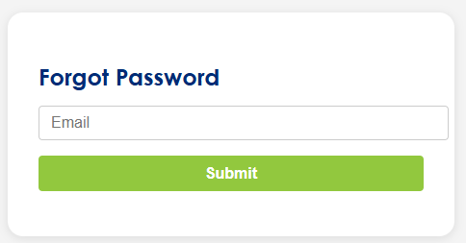
Wireframe Notes – 6.2 – Forgot Password
Forgot Password Screen
Input: Email
Submit button
Notes:
View Certificate: Could we have company name and product name at the top - should be designed to be visually appealing and more prominent then the rest.
Either way don't want it to say View Certificate
These are not editable in this view I would not make the fields look like they are text field boxes for editing should be visually appealing
Certificate #
format: add X: format should be: XX-XXXX
If someone tries to manually enter and number exists should have a popup box to confirm if still use or change
Switch Product Name and Company order and put all Product details in same column
Product Type Subcategory: Most will not have subcategory - will it be hidden or just be blank?
Placeholder Image: Make this thumbnail image of the actual certification. Include a preview option to view cert full screen in webpage. Also have download button to download cert (you have just make sure it's closer to the image of cert)
This is not used often but when it is it should appear -- they are also separate - it will be either email, url, or both
would move this to right or bottom so it does not impact other fields
Change external tags to: Tags:
Assume you are considering how we format to pass info in the way Amazon needs (via backend)

Slide 21
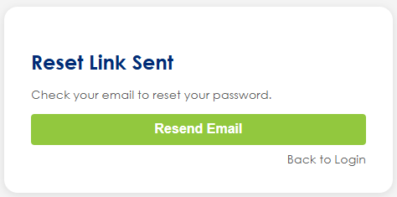
Wireframe Notes – 6.3 – Password Reset Confirmation
Password Reset Confirmation Screen (Email Sent)
Confirmation that an email was sent
Option to resend
Option to go back to Login
Notes:
View Certificate: Could we have company name and product name at the top - should be designed to be visually appealing and more prominent then the rest.
Either way don't want it to say View Certificate
These are not editable in this view I would not make the fields look like they are text field boxes for editing should be visually appealing
Certificate #
format: add X: format should be: XX-XXXX
If someone tries to manually enter and number exists should have a popup box to confirm if still use or change
Switch Product Name and Company order and put all Product details in same column
Product Type Subcategory: Most will not have subcategory - will it be hidden or just be blank?
Placeholder Image: Make this thumbnail image of the actual certification. Include a preview option to view cert full screen in webpage. Also have download button to download cert (you have just make sure it's closer to the image of cert)
This is not used often but when it is it should appear -- they are also separate - it will be either email, url, or both
would move this to right or bottom so it does not impact other fields
Change external tags to: Tags:
Assume you are considering how we format to pass info in the way Amazon needs (via backend)

Slide 22
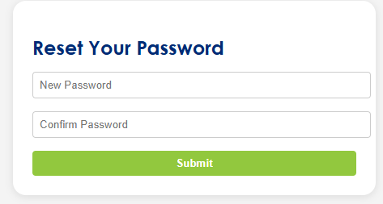
Wireframe Notes – 6.4 – Reset Password
Reset Password Screen
Accessed via email link (usually with token)
New Password + Confirm Password
Submit button
Notes:
View Certificate: Could we have company name and product name at the top - should be designed to be visually appealing and more prominent then the rest.
Either way don't want it to say View Certificate
These are not editable in this view I would not make the fields look like they are text field boxes for editing should be visually appealing
Certificate #
format: add X: format should be: XX-XXXX
If someone tries to manually enter and number exists should have a popup box to confirm if still use or change
Switch Product Name and Company order and put all Product details in same column
Product Type Subcategory: Most will not have subcategory - will it be hidden or just be blank?
Placeholder Image: Make this thumbnail image of the actual certification. Include a preview option to view cert full screen in webpage. Also have download button to download cert (you have just make sure it's closer to the image of cert)
This is not used often but when it is it should appear -- they are also separate - it will be either email, url, or both
would move this to right or bottom so it does not impact other fields
Change external tags to: Tags:
Assume you are considering how we format to pass info in the way Amazon needs (via backend)

Slide 23
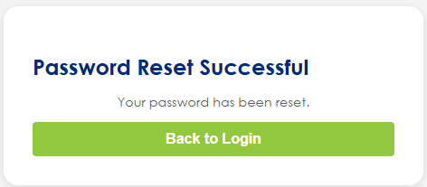
Wireframe Notes – 6.5 – Password Reset Successful
Password Reset Success Screen
Message: "Your password has been reset"
Button to go back to Login
Notes:
View Certificate: Could we have company name and product name at the top - should be designed to be visually appealing and more prominent then the rest.
Either way don't want it to say View Certificate
These are not editable in this view I would not make the fields look like they are text field boxes for editing should be visually appealing
Certificate #
format: add X: format should be: XX-XXXX
If someone tries to manually enter and number exists should have a popup box to confirm if still use or change
Switch Product Name and Company order and put all Product details in same column
Product Type Subcategory: Most will not have subcategory - will it be hidden or just be blank?
Placeholder Image: Make this thumbnail image of the actual certification. Include a preview option to view cert full screen in webpage. Also have download button to download cert (you have just make sure it's closer to the image of cert)
This is not used often but when it is it should appear -- they are also separate - it will be either email, url, or both
would move this to right or bottom so it does not impact other fields
Change external tags to: Tags:
Assume you are considering how we format to pass info in the way Amazon needs (via backend)

Slide 24
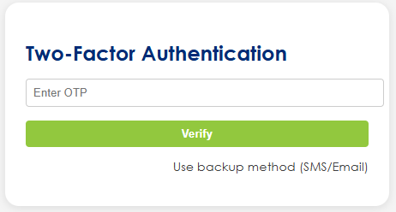
Wireframe Notes – 6.6 – 2FA Authenticate OTP
Two-Factor Authentication (2FA) Screen
Prompt for OTP or code from authenticator app
Backup methods (e.g., SMS, email)
Notes:
View Certificate: Could we have company name and product name at the top - should be designed to be visually appealing and more prominent then the rest.
Either way don't want it to say View Certificate
These are not editable in this view I would not make the fields look like they are text field boxes for editing should be visually appealing
Certificate #
format: add X: format should be: XX-XXXX
If someone tries to manually enter and number exists should have a popup box to confirm if still use or change
Switch Product Name and Company order and put all Product details in same column
Product Type Subcategory: Most will not have subcategory - will it be hidden or just be blank?
Placeholder Image: Make this thumbnail image of the actual certification. Include a preview option to view cert full screen in webpage. Also have download button to download cert (you have just make sure it's closer to the image of cert)
This is not used often but when it is it should appear -- they are also separate - it will be either email, url, or both
would move this to right or bottom so it does not impact other fields
Change external tags to: Tags:
Assume you are considering how we format to pass info in the way Amazon needs (via backend)

Slide 25
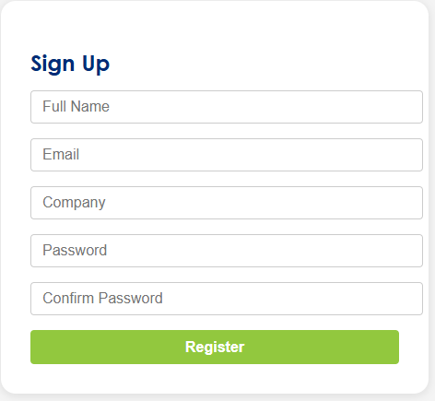
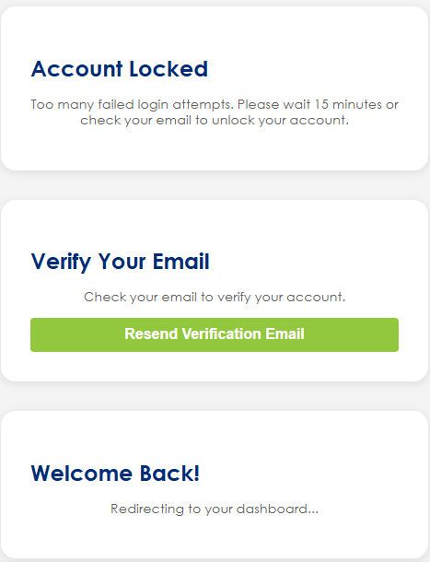
Wireframe Notes – 6.7 – Sign-up Registration (out of Scope)
Sign Up / Registration Screen (Disabled/Hidden)
If account creation is allowed in the future
Additional Screens:
Account Lock/Too Many Attempts Screen
Inform user of lockout
Time remaining or action to unlock (e.g., via email)
Email Verification Screen (Post Sign-up)
“Check your email to verify your account”
Resend Verification Email Screen
In case the user didn’t receive the initial verification
Login Success Redirect / Dashboard Screen
After login, redirect to home, dashboard, or intended page
Notes:
View Certificate: Could we have company name and product name at the top - should be designed to be visually appealing and more prominent then the rest.
Either way don't want it to say View Certificate
These are not editable in this view I would not make the fields look like they are text field boxes for editing should be visually appealing
Certificate #
format: add X: format should be: XX-XXXX
If someone tries to manually enter and number exists should have a popup box to confirm if still use or change
Switch Product Name and Company order and put all Product details in same column
Product Type Subcategory: Most will not have subcategory - will it be hidden or just be blank?
Placeholder Image: Make this thumbnail image of the actual certification. Include a preview option to view cert full screen in webpage. Also have download button to download cert (you have just make sure it's closer to the image of cert)
This is not used often but when it is it should appear -- they are also separate - it will be either email, url, or both
would move this to right or bottom so it does not impact other fields
Change external tags to: Tags:
Assume you are considering how we format to pass info in the way Amazon needs (via backend)

Slide 26
Wireframes

Slide 27
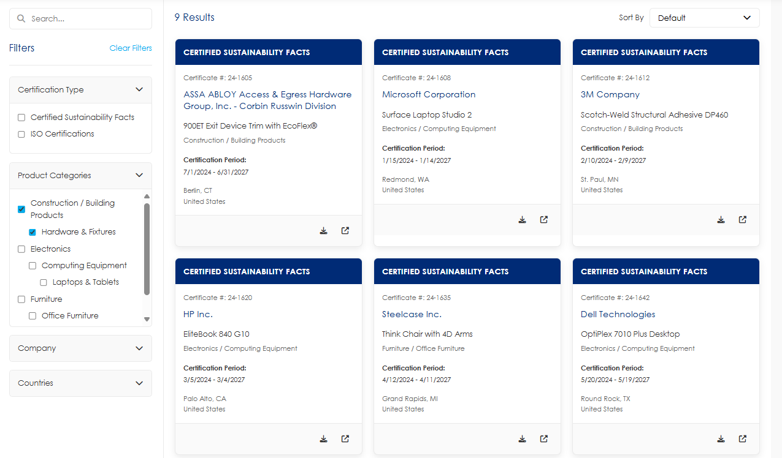
Wireframe Notes – 1.0 - Certificate List (Public Page)
Fields not included on Tile:
Company Contact Email/URL
Product Category
Product Subcategory
Tags
Notes:
Use only Century Gothic web safe font (not Cambria)
Will want a portion of the data to display on the tile and click-in to then have other fields. See example image for hierarchy and fields for title.
The header: Will likely want brief marketing intro content here
Global change: remove Product from Header
Remove Tags from Clear Filters/Tags.
What are the options for Sort By?
Global: Remove, the tags would be listed under “Additional” section as another search criteria. (Remove Quick Tags)
We will want to add an email info@greencirclecertified.com

Slide 28
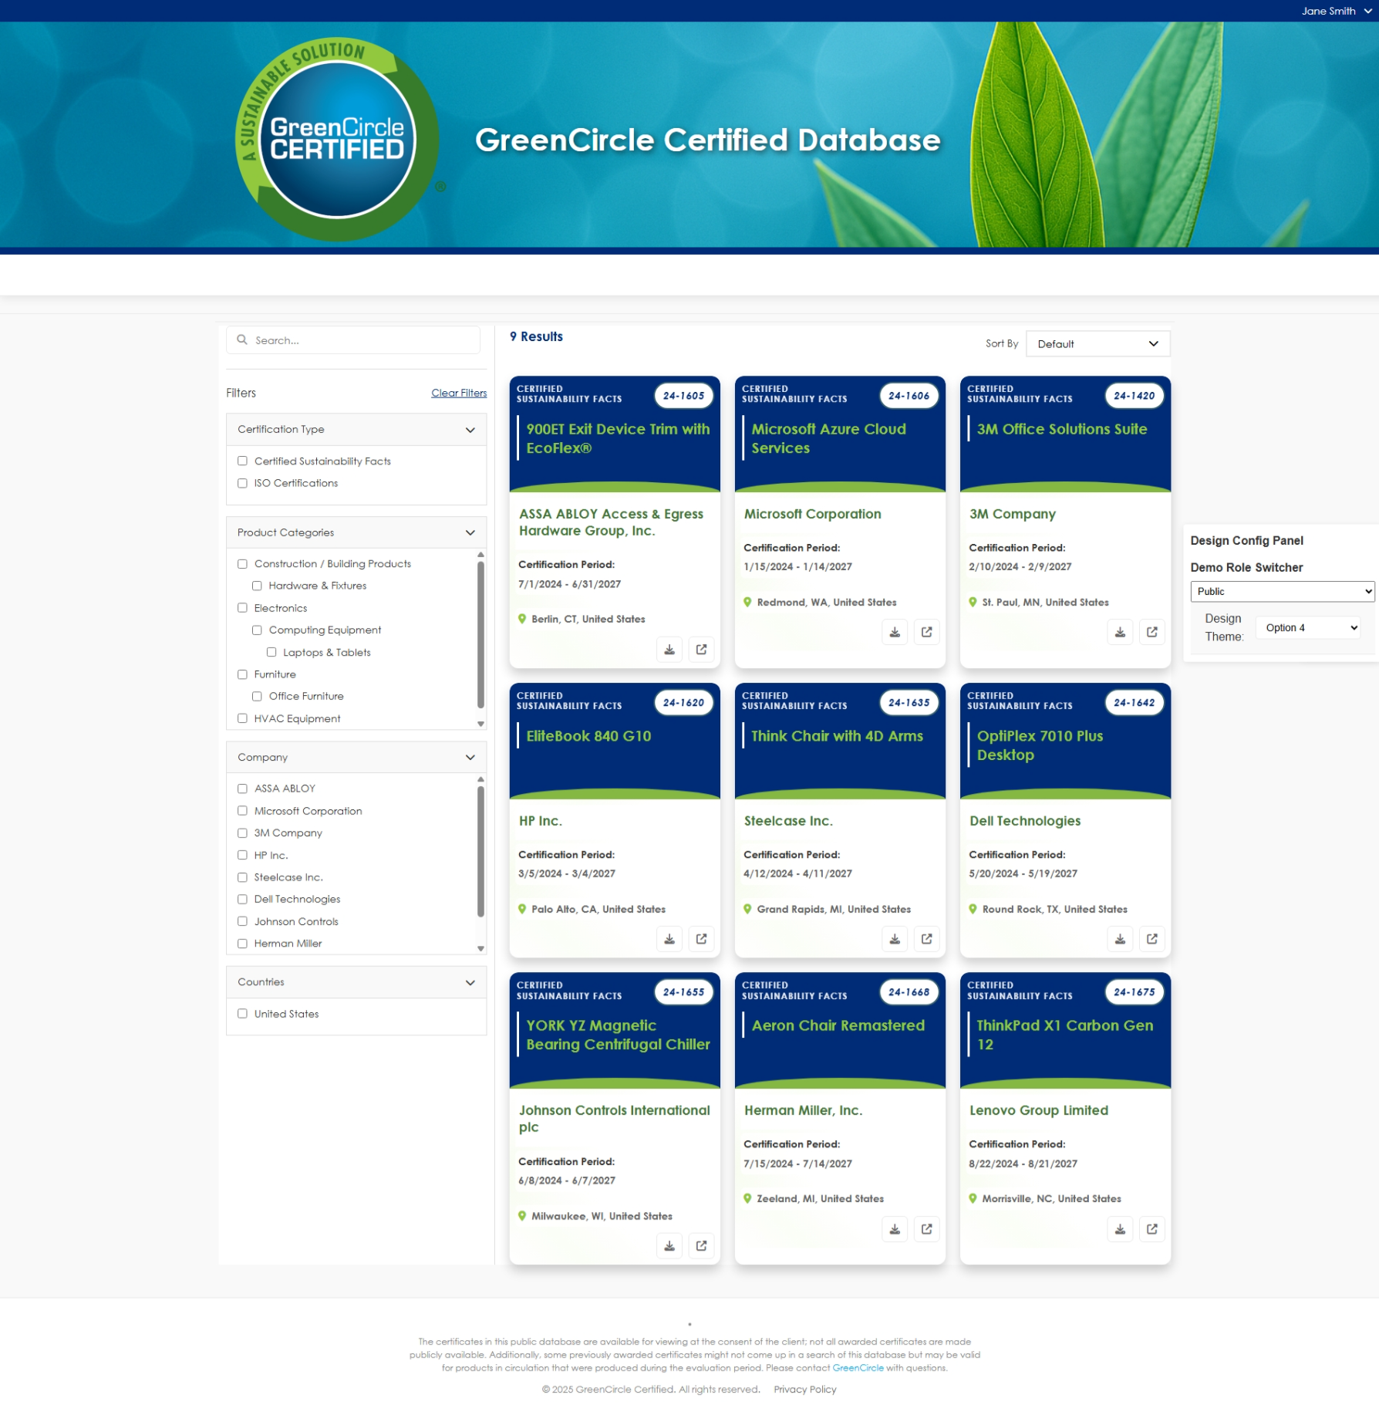
Wireframe Notes – 1.0 - Certificate List (Public Page) – Alt View 1
Fields not included on Tile:
Company Contact Email/URL
Product Category
Product Subcategory
Tags
Disclaimer is in the footer instead of the header an only visible on this page.
Notes:
Use only Century Gothic web safe font (not Cambria)
Will want a portion of the data to display on the tile and click-in to then have other fields. See example image for hierarchy and fields for title.
The header: Will likely want brief marketing intro content here
Global change: remove Product from Header
Remove Tags from Clear Filters/Tags.
What are the options for Sort By?
Global: Remove, the tags would be listed under “Additional” section as another search criteria. (Remove Quick Tags)
We will want to add an email info@greencirclecertified.com

Slide 29
Wireframe Notes – 1.0 - Certificate List (Public Page) – Alt View 2
Fields not included on Tile:
Company Contact Email/URL
Product Category
Product Subcategory
Tags
Notes:
Use only Century Gothic web safe font (not Cambria)
Will want a portion of the data to display on the tile and click-in to then have other fields. See example image for hierarchy and fields for title.
The header: Will likely want brief marketing intro content here
Global change: remove Product from Header
Remove Tags from Clear Filters/Tags.
What are the options for Sort By?
Global: Remove, the tags would be listed under “Additional” section as another search criteria. (Remove Quick Tags)
We will want to add an email info@greencirclecertified.com

Slide 30
Wireframe Notes – 1.0 - Certificate List (Public Page)
This is the landing page (https://db.greencirclecertified.com/certificate) on the current website.
Clicking anywhere on the tile of a certificate will take the user to the Certificate View, separate page that opens into a new window, that shows details about the selected certificate.
Search bar, autocomplete suggestions, filters on search terms within results, mobile compatibility, and the ability to narrow down search results based on specific criteria within categories, allowing users to easily find specific content on a site.
Ability to sort tiles on all Public database columns (Certificate #, Certification Type, Effective Date, Expiration Date, Company, Company Contact Email/URL, Product Name, Product Category, Product Type, Product Type Subcategory, Location, Country, External Tag) (Striked out does not need sorting)
Ability to filter by search categories
All Public data fields to be displayed: Certificate #, Certification Type, Effective Date, Expiration Date, Company, Company Contact Email/URL, Product Name, Product Category, Product Type, Product Type Subcategory, Location, Country, External Tag
Need to make sure a unique URL can be created based on search criteria so clients can directly link to DB with just listing of their certifications (SCS does this as you add search criteria). Unique URL per Certification View for direct cert access.
Ability to view # Results
Ability to Clear filters
Certification download capability. Ability to download certificate directly from tile via download icon.
*Wishlist: The ability to load the table as a user scrolls Lazy loading, rather than have the page control.
Notes:
I don't understand what this means - on https://www.greencirclecertified.com/ you select Certified Product Database to get to this location
If you are talking about how someone signs in that would be Sign In. We should not need to say Go to Portal anymore
What are available sort options?

Slide 31
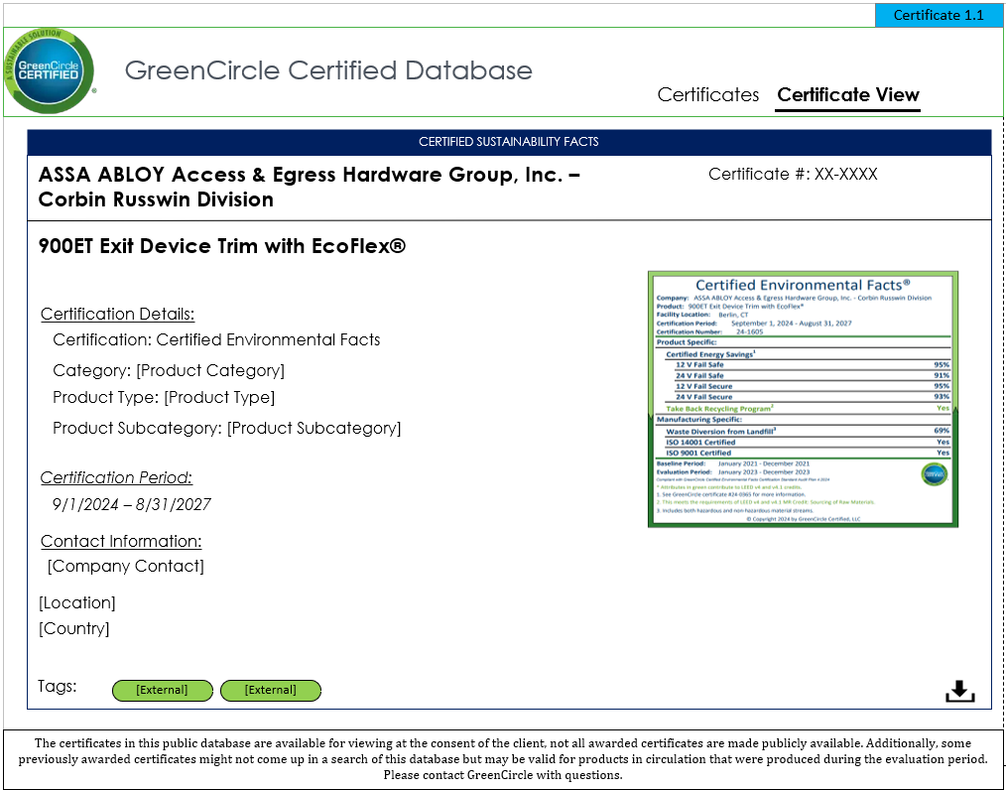
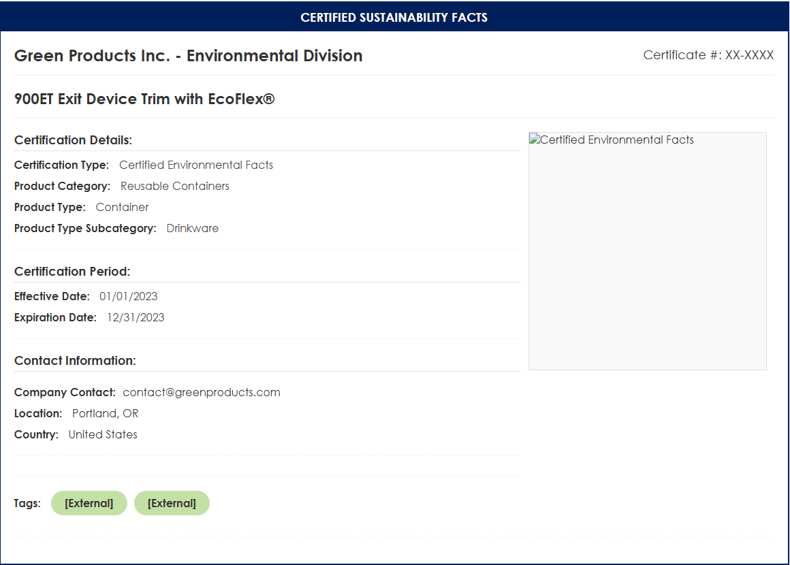
Wireframe Notes – 1.1 – Single Certificate View
Notes:
This is the Single Cert View for Public Users.
Ability to view all Public data fields for the selected Single Certificate.
Opens in a new tab.
Ability to Download the Certificate.
Certificate view will load into a new tab.
TODO: Move location and country under Certification details.
Add Company URL under Company Contact.
Provide mobile view of Screen.
Notes:
View Certificate: Could we have company name and product name at the top - should be designed to be visually appealing and more prominent then the rest.
Either way don't want it to say View Certificate
These are not editable in this view I would not make the fields look like they are text field boxes for editing should be visually appealing
Certificate #
format: add X: format should be: XX-XXXX
If someone tries to manually enter and number exists should have a popup box to confirm if still use or change
Switch Product Name and Company order and put all Product details in same column
Product Type Subcategory: Most will not have subcategory - will it be hidden or just be blank?
Placeholder Image: Make this thumbnail image of the actual certification. Include a preview option to view cert full screen in webpage. Also have download button to download cert (you have just make sure it's closer to the image of cert)
This is not used often but when it is it should appear -- they are also separate - it will be either email, url, or both
would move this to right or bottom so it does not impact other fields
Change external tags to: Tags:
Assume you are considering how we format to pass info in the way Amazon needs (via backend)

Slide 32
Wireframe Notes – 1.1 – Single Certificate View (Mobile View)
Notes:
This is the Single Cert View for Public Users.
Ability to view all Public data fields for the selected Single Certificate.
Opens in a new tab.
Ability to Download the Certificate.
Certificate view will load into a new tab.
TODO: Move location and country under Certification details.
Add Company URL under Company Contact.
Provide mobile view of Screen.
Notes:
View Certificate: Could we have company name and product name at the top - should be designed to be visually appealing and more prominent then the rest.
Either way don't want it to say View Certificate
These are not editable in this view I would not make the fields look like they are text field boxes for editing should be visually appealing
Certificate #
format: add X: format should be: XX-XXXX
If someone tries to manually enter and number exists should have a popup box to confirm if still use or change
Switch Product Name and Company order and put all Product details in same column
Product Type Subcategory: Most will not have subcategory - will it be hidden or just be blank?
Placeholder Image: Make this thumbnail image of the actual certification. Include a preview option to view cert full screen in webpage. Also have download button to download cert (you have just make sure it's closer to the image of cert)
This is not used often but when it is it should appear -- they are also separate - it will be either email, url, or both
would move this to right or bottom so it does not impact other fields
Change external tags to: Tags:
Assume you are considering how we format to pass info in the way Amazon needs (via backend)

Slide 33
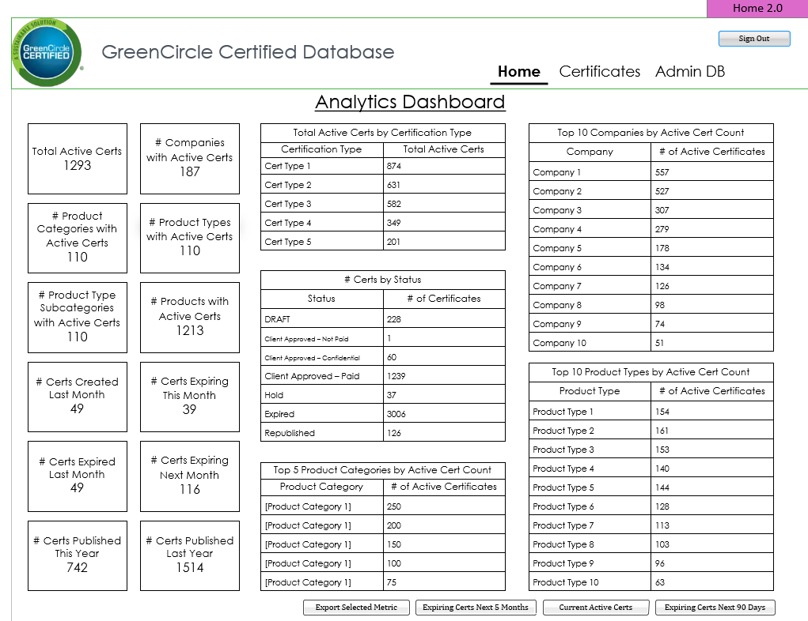
Wireframe Notes – 2.0 – Home (Dashboard)
Notes:
This is the dashboard reporting page for logged in GCC users (Analyst and Admins).
Containers represent the required metrics.
Ability to view designated metrics.
Ability to export Prebuilt Lists to Excel.
Ability to export the selected metric to Excel.
Questions:
Confirm navigation and layout
Other
Nice to have, not part of scope, would be to have the dashboard available for external users with there specific data.
TODO: There is no check box to select a metric. Instead include a download icon in each box and that will be how you download the data.
Remove Export Selected Metric
Updates pending
Notes:
Home: Unless you can make the data dynamic based on a user's data permissions -- then this will only be accessible to GCC Analyst/Admin roles - therefore, external login users would not see this nav item or this page
Prebuilt lists: Export to Excel buttons: Put at bottom of page after metrics
Missing: Top 5 Product Categories by Active Cert Count
Can Admin create new widgets? Not for this phase.

Slide 34
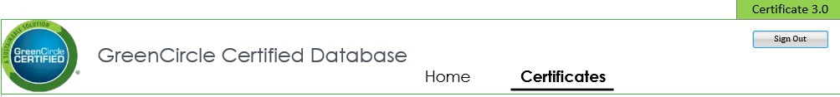
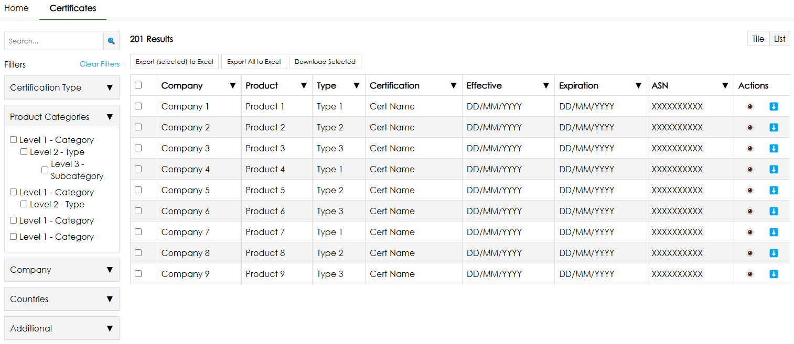
Wireframe Notes – 3.0 – Certificate List (External)
Notes:
Wireframe updated for infinite scrolling instead of pagination.
Add Certificates will only be available for Analyst and Admin users.
Edit/Delete Certificate will only be available for Analyst and Admin users.
Ability to toggle between List and Tile views.
The Tile view will display the same as 1.0 Certificate view.
List Sort by will allows users to sort on any column.
All data fields to be displayed based on user’s permissions: Certificate #, Certification Type, CSF Attributes, Status, Effective Date, Expiration Date, Company, Company Contact Email/URL, Product Name, Product Category, Product Type, Product Type Subcategory, Location, Country, External Tag, Internal Tag, ASIN, UPC, GTIN, EAN, Certificate Upload, Record Created Date, Record Last Updated Date, Preview
2 types of External Users
  Customers (accounted for here)
  Partners (where they will have access across companies for products that are part of their program only – for example Amazon CPF clients/certs) (Need Clarification)
Defaults to List View
Updates pending
  Notes:
  Move actions to left side of table.
  need to be able to see the Product listing for only ones under their program…with no editing capability.
  Can only see Internal tags if there assigned?(Was this a req?)
  Preview refers to the eye icon
  Discuss: how would you handle where there are thousands of ASINs under a cert.
    May need to give Products page access to external users because listing here would not be realistic. In which case there would not be a column for this, UPC, etc.
Notes:
Remove Tags from Clear Filters/Tags
Paging; allow minimum of 50 per page
Remove Quick tags: global change.
Add Certificates This would only appear for GCC Analyst and Admin - how will this be managed
This will be managed by using page level security. Only GCC analyst and Admin will be able to see or use this functionality.
TODO: Add screen to show this functionality.
Edit Selected Certificate: How does this work when you can multi-select. Either you need to add a row with icons to edit or upon clicking on a single record it opens edit screen but only for internal users
Download Selected Is this to download certifications of items selected? If so make button copy more clear. Also if none are selected and button is clicked will error popup display?
Export Selected to Excel and Export all to Excel: I think you only need 1 button. If you have no filters it will download all. If you have filters selected it will only download your results. This is how current DB works
Can we have a cert preview column (could be little expand / eye icon) - which would display cert image in webpage view. They will also have ability to download but this is just if they want to see it

Slide 35
Wireframe Notes – 3.0 – Certificates List (External)
This is the List View for Logged In Users.
Clicking anywhere on the row of a certificate will take the user to the Certificate List that shows details about the selected Certificate.
Ability to Sort on all columns.
Ability to Filter by designated Search Categories.
Ability to scroll horizontally and vertically to see additional data fields.
Ability to multiselect for Certificate Download.
Excel download - based on filters can export full or filtered list
Wishlist: The ability to load the table as a user scrolls Lazy loading, rather than have the page control.
Notes:
We need to make sure only GCC users have edit access to a certificate record

Slide 36
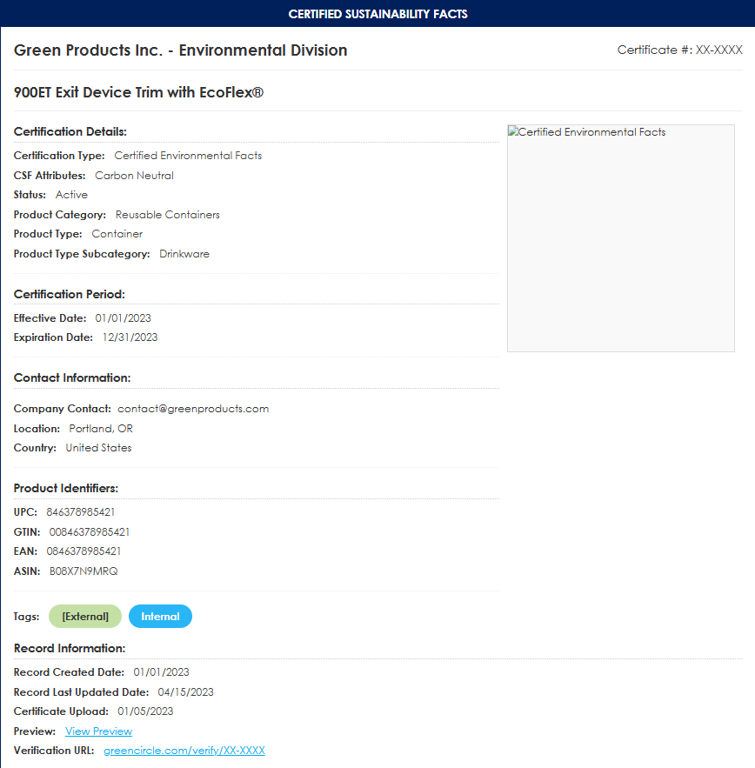
Wireframe Notes – 3.1 – External Single Certificate View
All data fields to be displayed based on user’s permissions: Certificate #, Certification Type, CSF Attributes, Status, Effective Date, Expiration Date, Company, Company Contact Email/URL, Product Name, Product Category, Product Type, Product Type Subcategory, Location, Country, External Tag, Internal Tag, ASIN, UPC, GTIN, EAN, Certificate Upload, Record Created Date, Record Last Updated Date, Preview.
Verification URL: displayed at bottom of page to enable
Certificate View will load in a new tab.
CSF Attribute will only show when it is selected for a certification. (The field will not be required on the certificate create page)
Record Information will only be available for Analyst and Admin
Updates pending
  Update Screenshot, remove Record Information.
Notes:
Home: They wouldnt see this unless dashboard data reflects their data access.
Not just clients - partners will also be external users and will see certs associated with their program
Add Certificat Button: Remove They could not add Cert remove
Apply applicable comments from page 22

Slide 37
Wireframe Notes – 3.1 – External Single Certificate View
This is the List View for Logged In Clients.
Ability to Sort on all columns.
Ability to Filter by designated Search Categories.
Ability to scroll horizontally and vertically to see additional data fields.
Ability to multiselect for Download.
Will Clients fall under the ‘Company’ data field or is there another way to associate them to a Product/Certificate?
  When we grant permissions to clients it would be through Company - and there could be multiple companies associated with 1 client (ASSA ABLOY for example). However, on the partner side they would not be by Company but by new partner field.
Notes:
When we grant permissions to clients it would be through Company - and there could be multiple companies associated with 1 client (ASSA ABLOY for example)
However, on the partner side they would not be by Company but by tag or new field

Slide 38
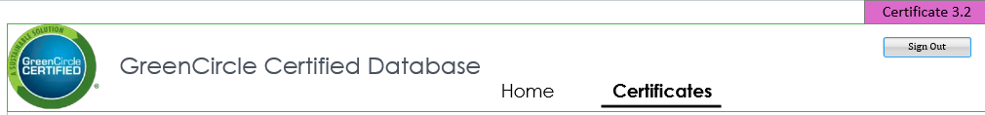
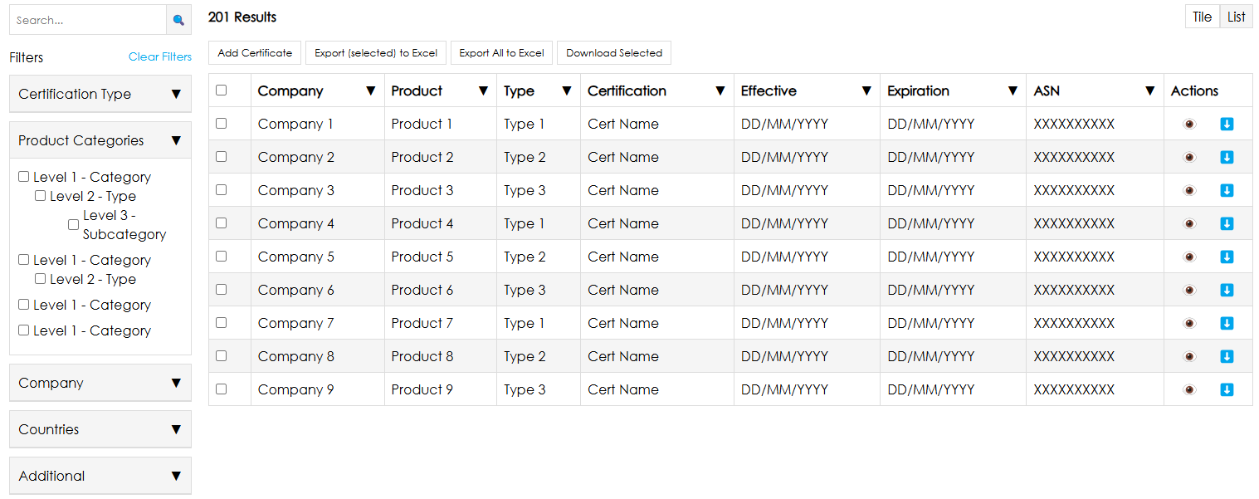
Wireframe Notes – 3.2 – Certificate List (GCC Only)
Notes:
Wireframe updated for infinite scrolling instead of pagination.
Add Certificates will only be available for Analyst and Admin users.
Edit/Delete Certificate will only be available for Analyst and Admin users.
Ability to toggle between List and Tile views.
The Tile view will display the same as 1.0 Certificate view.
List Sort by will allows users to sort on any column.
All data fields to be displayed based on user’s permissions: Certificate #, Certification Type, CSF Attributes, Status, Effective Date, Expiration Date, Company, Company Contact Email/URL, Product Name, Product Category, Product Type, Product Type Subcategory, Location, Country, External Tag, Internal Tag, ASIN, UPC, GTIN, EAN, Certificate Upload, Record Created Date, Record Last Updated Date, Preview
Updates pending
  Add Edit icon for GCC users
  Update table based on how ASIN, UPC, etc will be handled.
  Right align Add certificate button and make green primary to draw attention to it.
Notes:
Remove Tags from Clear Filters/Tags
Paging; allow minimum of 50 per page
Remove Quick tags: global change.
Add Certificates This would only appear for GCC Analyst and Admin - how will this be managed
This will be managed by using page level security. Only GCC analyst and Admin will be able to see or use this functionality.
TODO: Add screen to show this functionality.
Edit Selected Certificate: How does this work when you can multi-select. Either you need to add a row with icons to edit or upon clicking on a single record it opens edit screen but only for internal users
Download Selected Is this to download certifications of items selected? If so make button copy more clear. Also if none are selected and button is clicked will error popup display?
Export Selected to Excel and Export all to Excel: I think you only need 1 button. If you have no filters it will download all. If you have filters selected it will only download your results. This is how current DB works
Can we have a cert preview column (could be little expand / eye icon) - which would display cert image in webpage view. They will also have ability to download but this is just if they want to see it

Slide 39
Wireframe Notes – 3.2 – Certificate List (GCC Only)
This is the List View for Logged In Users.
Clicking anywhere on the row of a certificate will take the user to the Certificate List that shows details about the selected Certificate.
Ability to Sort on all columns.
Ability to Filter by designated Search Categories.
Ability to scroll horizontally and vertically to see additional data fields.
Ability to multiselect for Certificate Download.
Ability to Add a Certificate.
Ability to Edit/Delete a selected Certificate.
Note: Edit/Delete will be one at a time, no multiselect.
Excel download - based on filters can export full or filtered list
*Wishlist: The ability to load the table as a user scrolls Lazy loading, rather than have the page control.
Notes:
We need to make sure only GCC users have edit access to a certificate record
All data fields to be displayed based on user’s permissions: Certificate #, Certification Type, CSF Attributes, Status, Effective Date, Expiration Date, Company, Company Contact Email/URL, Product Name, Product Category, Product Type, Product Type Subcategory, Location, Country, External Tag, Internal Tag, ASIN, UPC, GTIN, EAN, Certificate Upload, Record Created Date, Record Last Updated Date, Preview

Slide 40
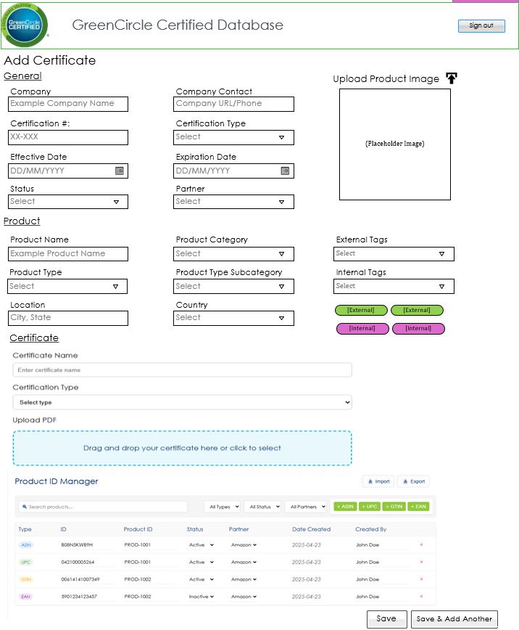
Wireframe Notes – 3.3 – Add Certificate (GCC Only)
Notes:
Admin can add new product categories.
Certification # will be auto generated by the database and created on the save (As discussed prior, unless manually entered, you need instructional copy on the page for this like current db)
New Field: Partner: Amazon/Wayfair - required. (Need to add option of none and multiselect)
New Field: Status Type: to signify if a client doesn’t want to move forward. (This was added based on meeting)
Products will only show if they are associated with the certificate that is being displayed.
Users can select from dropdown existing Products or add a new. Product Category, Type, and Subcategory are not editable on this page and are assigned when adding a new product.
Updates pending
  Update Screenshot, add record information.
  Remove image section
  Change Product ID Manager to Products
  Company Contact should be two different fields. URL and Email (Phone?)
    Info should carry over from the Companies page fields, so it should not be open to edit here. When selecting company it would autopopulate.
Notes:
Anuki explore options for: Clone feature that only carries over certain fields like Cert Type, Company, Dates, Location, Country, Company Contact
And potential Excel mass upload
This would be best on a page not a popup given the amount of fields. Would want it to open in new tab when cert is selected for editing.
How are you allowing mass upload of Amazon ASINs (or UPC, GTIN, EAN)? On these pages we need the listing of ASINs/UPC/etc. that are covered under the cert.
Need to be able to copy and paste ASIN (or other) list or upload in bulk.
We need to add other fields specific to the ASIN associated product. I see that list associated with cert in this view at the botto
You need to show how a GCC Analyst will search/add new Company and Product Names
You need to show how available options show for company or product names -- then if there is not one how to add a new (like current DB)
Also, Product selection is editable AFTER company is selected so it will show the associated products from that company already available
You need to show how you add a New Product and tie that product to the right project type -- within this interface/popup not just in the Products page (see current DB)
Product Name is not a required field.
Certificate #: Not accounting for notification that if left blank will auto assign. Unless you are planning some other way to handle this? But this is key functionality for cert numbering.
Company – Move to General Section
Company Contact: These are either URL or an email address (not phone number). Move to General Section
Location and Country: Put this under General because it could be product or facility level cert
Should list Created On and Last Modified (these fields are system generated and not editable)
and what User Last Modiified
Missing a bunch of fields like CSF Attributes, ASIN, UPC, GTIN, EAN
DISCUSS WITH TEAM: For CSF Attributes: If a specific attribute from the dropdown is selected than that cert would appear in the public search for that cert type. For example if the CSF has Recycled Content, then the CSF would appear when selecting Recycled Content
Tags should be color coded for internal vs external
Need ability to upload certificate file and preview button
Change Submit to Save

Slide 41
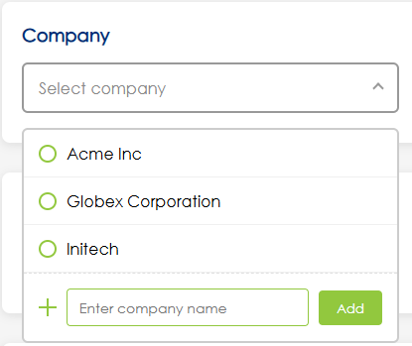
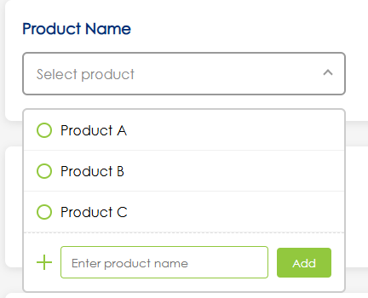
Wireframe Notes – 3.3 – Add Certificate (GCC Only)
Updates pending
Notes:
Both Company and Products will be managed on separate Admin pages.
* Analyst may or not have access to these pages. The design of the system will enable this capability in the future.
Company
  Company Name and …???
These are the Company DD on the Certificate page. Multi-select?
Notes:
Anuki explore options for: Clone feature that only carries over certain fields like Cert Type, Company, Dates, Location, Country, Company Contact
And potential Excel mass upload
This would be best on a page not a popup given the amount of fields. Would want it to open in new tab when cert is selected for editing.
How are you allowing mass upload of Amazon ASINs (or UPC, GTIN, EAN)? On these pages we need the listing of ASINs/UPC/etc. that are covered under the cert.
Need to be able to copy and paste ASIN (or other) list or upload in bulk.
We need to add other fields specific to the ASIN associated product. I see that list associated with cert in this view at the botto
You need to show how a GCC Analyst will search/add new Company and Product Names
You need to show how available options show for company or product names -- then if there is not one how to add a new (like current DB)
Also, Product selection is editable AFTER company is selected so it will show the associated products from that company already available
You need to show how you add a New Product and tie that product to the right project type -- within this interface/popup not just in the Products page (see current DB)
Product Name is not a required field.
Certificate #: Not accounting for notification that if left blank will auto assign. Unless you are planning some other way to handle this? But this is key functionality for cert numbering.
Company – Move to General Section
Company Contact: These are either URL or an email address (not phone number). Move to General Section
Location and Country: Put this under General because it could be product or facility level cert
Should list Created On and Last Modified (these fields are system generated and not editable)
and what User Last Modiified
Missing a bunch of fields like CSF Attributes, ASIN, UPC, GTIN, EAN
DISCUSS WITH TEAM: For CSF Attributes: If a specific attribute from the dropdown is selected than that cert would appear in the public search for that cert type. For example if the CSF has Recycled Content, then the CSF would appear when selecting Recycled Content
Tags should be color coded for internal vs external
Need ability to upload certificate file and preview button
Change Submit to Save

Slide 42
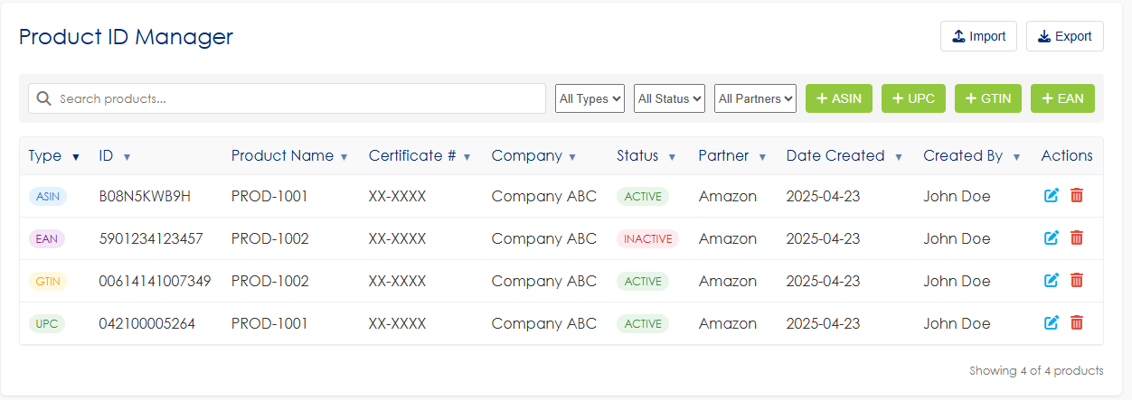
Wireframe Notes – 3.3 – Products
Updates pending
I think Partners and Clients should have access to this without the add, edit, delete and import items. They would also see based on their permissions.
This is the wrong section. Not 3.3
Transform Type to individual columns (ASIN, EAN, GTIN, UPC)
Make this the first column then product name, company, status, partner, then numbers.
Review: Would need to allow multiple parnters.
  The API would identify what get passed per…..????
What about multi-select for deletion and status change
Isn't this same as page 59? See those comments too, is this the one just for bottom of cert page?
REVIEW: would need to allow multiple partners.!!!!!
THE API would identify what gets paseed per…..???
Notes:
Product identifier management for multiple types: ASIN, UPC, GTIN, and EAN
Search functionality to quickly find products
Filtering options by type, status, and partners
Status tracking (Active/Inactive) for each product ID
Partner association (currently showing Amazon)
Creation date and creator tracking
Import and export capabilities for bulk management
Adding new identifiers with dedicated buttons for each type
Linking multiple identifier types to the same product ID (as shown with PROD-1001 and PROD-1002)
Table view with deletion options (x button) for each entry
Notes:
Anuki explore options for: Clone feature that only carries over certain fields like Cert Type, Company, Dates, Location, Country, Company Contact
And potential Excel mass upload
This would be best on a page not a popup given the amount of fields. Would want it to open in new tab when cert is selected for editing.
How are you allowing mass upload of Amazon ASINs (or UPC, GTIN, EAN)? On these pages we need the listing of ASINs/UPC/etc. that are covered under the cert.
Need to be able to copy and paste ASIN (or other) list or upload in bulk.
We need to add other fields specific to the ASIN associated product. I see that list associated with cert in this view at the botto
You need to show how a GCC Analyst will search/add new Company and Product Names
You need to show how available options show for company or product names -- then if there is not one how to add a new (like current DB)
Also, Product selection is editable AFTER company is selected so it will show the associated products from that company already available
You need to show how you add a New Product and tie that product to the right project type -- within this interface/popup not just in the Products page (see current DB)
Product Name is not a required field.
Certificate #: Not accounting for notification that if left blank will auto assign. Unless you are planning some other way to handle this? But this is key functionality for cert numbering.
Company – Move to General Section
Company Contact: These are either URL or an email address (not phone number). Move to General Section
Location and Country: Put this under General because it could be product or facility level cert
Should list Created On and Last Modified (these fields are system generated and not editable)
and what User Last Modiified
Missing a bunch of fields like CSF Attributes, ASIN, UPC, GTIN, EAN
DISCUSS WITH TEAM: For CSF Attributes: If a specific attribute from the dropdown is selected than that cert would appear in the public search for that cert type. For example if the CSF has Recycled Content, then the CSF would appear when selecting Recycled Content
Tags should be color coded for internal vs external
Need ability to upload certificate file and preview button
Change Submit to Save

Slide 43
Wireframe Notes – 3.3 – Add Certificate (GCC Only)
This is the Add Certificate View.
All Internal View Data:: Certificate #, Certification Type, CSF Attributes, Status, Effective Date, Expiration Date, Company, Company Contact Email/URL, Product Name, Product Category, Product Type, Product Type Subcategory, Location, Country, External Tag, Internal Tag, ASIN, UPC, GTIN, EAN, Certificate Upload, Record Created Date, Last Edited By, Record Last Updated Date, Preview
Ability to Add a Certificate with all Required Data Fields.
**Which data fields are required to Add a Cert?
  Cert Type, Status, Effective Date, Expiration Date, Company, Product Category (required when you have product name), Product Type (required when you have product name), Location, Country, Partner.
  Need to make sure we have N/A option for Product Category, Product Type, Subcategory, Partner.
  Cer # is required – but auto generated by DB if not manually entered.
Which data fields will be generated by the system after adding?
  Just Cert number. It would pull in company contact fields from companies page. System also needs to automatically remove expired and inactive certs from public view.
Ability to upload an image to use for the Product.
**Should we incorporate Product Image?
Notes:
This is in doc provided --- only changes are:
Product Name - not required
Product Category - required if there is a Product Name
Certificated Upload - not required

Slide 44
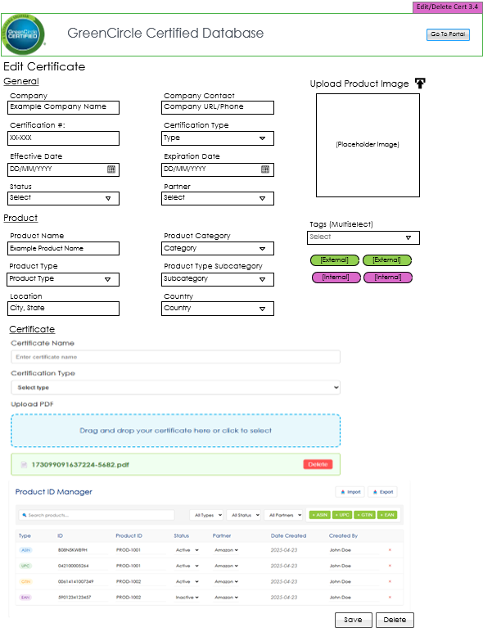
Wireframe Notes – 3.4 – Edit/Delete Certificate (GCC Only)
Updates pending
Admin can add new product categories.
Certification # will be auto generated by the database and created on the save
New Field: Partner: Amazon/Wayfair - required.
New Field: Status Type: to signify if a client doesn’t want to move forward.
This is the Edit/Delete Certificate View.
All Internal View Data: Certificate #, Certification Type, CSF Attributes, Status, Effective Date, Expiration Date, Company, Company Contact Email/URL, Product Name, Product Category, Product Type, Product Type Subcategory, Location, Country, External Tag, Internal Tag, ASIN, UPC, GTIN, EAN, Certificate Upload, Record Created Date, Last Edited By, Record Last Updated Date, Preview
Company Contact: separate into two URL/Email (phone?)
Ability to Edit/Delete the selected Certificate information and file.
The Products section should only show products under the Cert# being viewed.
Users can select from dropdown existing Products or add a new. Product Category, Type, and Subcategory are not editable on this page and are assigned when adding a new Product. (see current DB?)
Notes:
Same comments as other page. Need to also be able to remove and replace prior cert PDF
There should be a confirmation box that appears asking if they are sure they want to delete

Slide 45
Wireframe Notes – 5.0 – Companies & Products
Navigation only, not a page.

Slide 46
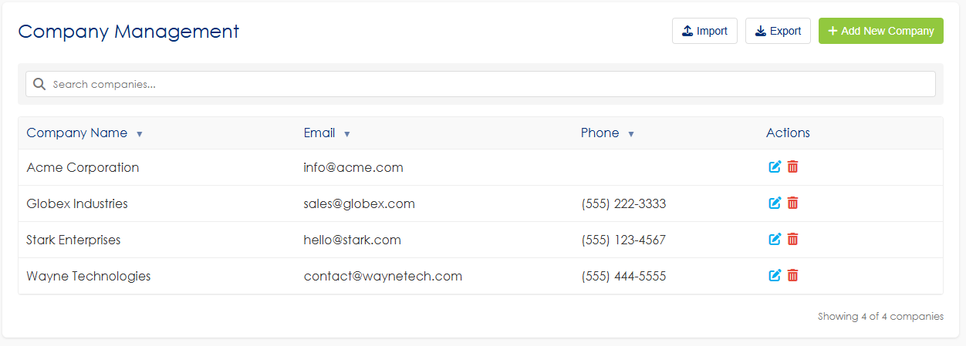
Wireframe Notes – 5.1 – Companies
Updates pending
Company Management screen:
  Includes: Company Name, Company Contact
  Separate out Contact Email and Phone into two separate fields
DISCUSS: Does this information populate under the cert if it’s listed here? If we aren’t using this to auto populate that then we don’t need anything, but company name here.
Will import ever override current?
  The import will do a compare of the data to only upload new records.
  If existing Certficate # is uploaded it will update the fields that have changed.
    History table will be updated in the DB of the change.
Does email get used on the Cert? If so rename so more clear…
Does Phone get used on the Cert? If so replace with URL on Cert.
Only email and URL as contact options.
Notes:
Need a way to be able to delete and edit Product Names (in case had issue with prior or Product Name is no longer valid)
We may need a Products page added to be able to edit and remove records (similar to current DB)
Purpose of the Select All?
With so many product types will want to be able to search and sort this list
Product Type Subcategory: Why are these numbered and with multiple?
Ability to sort by alphabetical order for any column
Can just click on to edit since you can't edit multiple at once
Remove item from Add New button
With so many product types will want to be able to search and sort this list

Slide 47
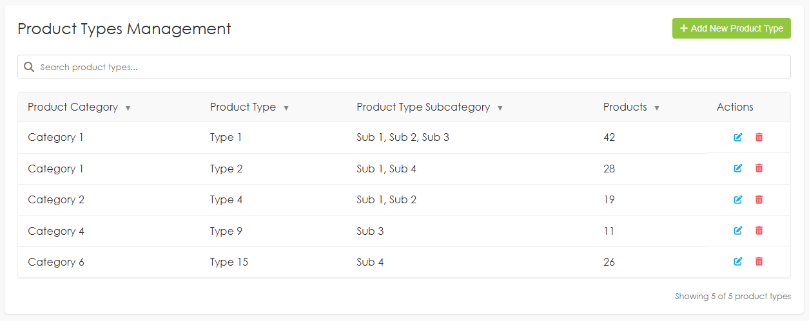
Wireframe Notes – 5.2 – Product Types
This is the Product Types Admin View.
Ability to Add Product Categories, Types, and Type Subcategories.
Ability to Edit/Delete Selected Line Item.
One-to-Many relationship between Product Categories, Types, and Type Subcategories.
Notes:
Need a way to be able to delete and edit Product Names (in case had issue with prior or Product Name is no longer valid)
We may need a Products page added to be able to edit and remove records (similar to current DB)
Purpose of the Select All?
With so many product types will want to be able to search and sort this list
Product Type Subcategory: Why are these numbered and with multiple?
Ability to sort by alphabetical order for any column
Can just click on to edit since you can't edit multiple at once
Remove item from Add New button
With so many product types will want to be able to search and sort this list

Slide 48
Wireframe Notes – 7.0 – Administration
Admin Section does not have a main landing page.

Slide 49
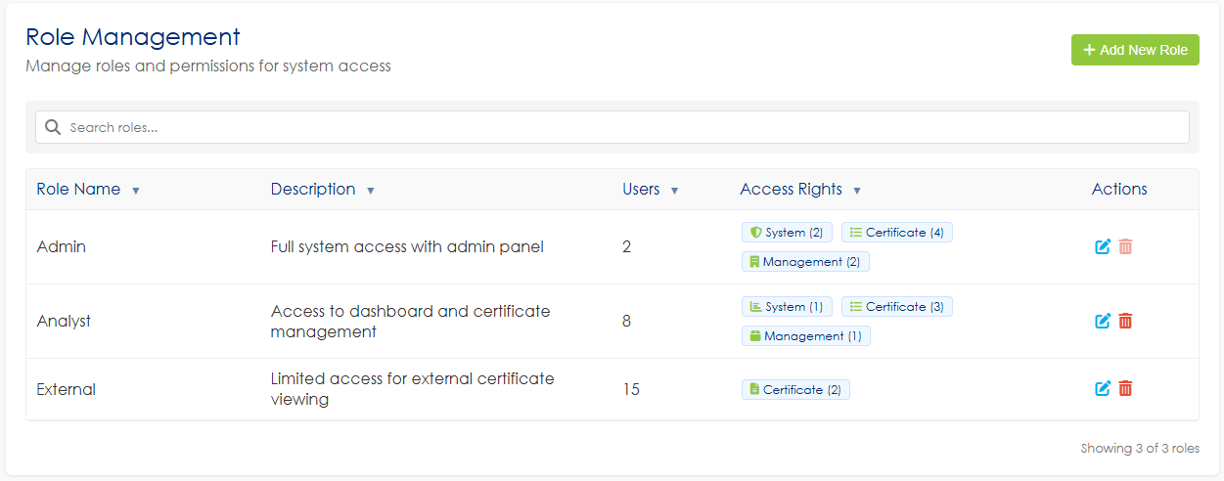
Wireframe Notes – 7.1 – Role Management
This is the Role Management (Page Level) Admin View.
Ability to Manage which roles have access to which pages of the site.
Ability to cancel changes.
Admin Users have access to all pages by default.
Delete disabled for Admin, Admin Panel checkbox disabled for Admin.
Notes:
Change Submit to Save
Cancel word remove
What do you mean by pages? Trying to understand a use case for this. Sometimes we have same pages but the features on them could be different
The external user needs to be based on selected field filters or field types, which is not represented and needs to be accounted for. It would be unique per USER, not really by role. May be nice to clone these users if we have several from 1 org with same access level

Slide 50
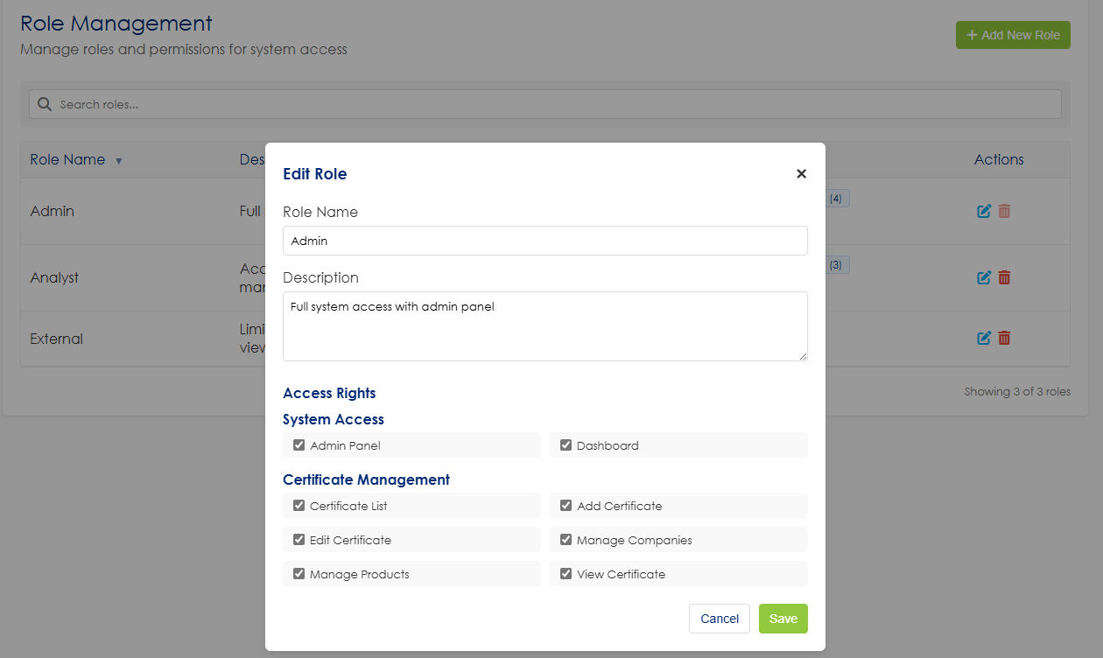
Wireframe Notes – 7.1 – Role Management
Notes:
Change Submit to Save
Cancel word remove
What do you mean by pages? Trying to understand a use case for this. Sometimes we have same pages but the features on them could be different
The external user needs to be based on selected field filters or field types, which is not represented and needs to be accounted for. It would be unique per USER, not really by role. May be nice to clone these users if we have several from 1 org with same access level

Slide 51
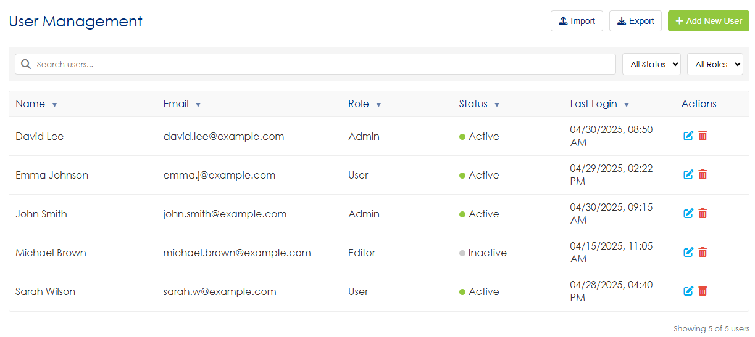
Wireframe Notes – 7.1.1 – User Management
This is the Users (Roles) Admin View.
Ability to Add a new User.
Ability to Edit a selected current User.
an only Edit one user at a time.
Ability to navigate between admin screens via navigation.
Notes:
Add: Ability to export user list
Is Edit Selected User button needed?
Remove (Roles) from image
What is the select checkbox for? Why couldn't you just click on user and go into edit view
Only thing i can see multi-select helpful for is to delete users
Add Column for Company

Slide 52
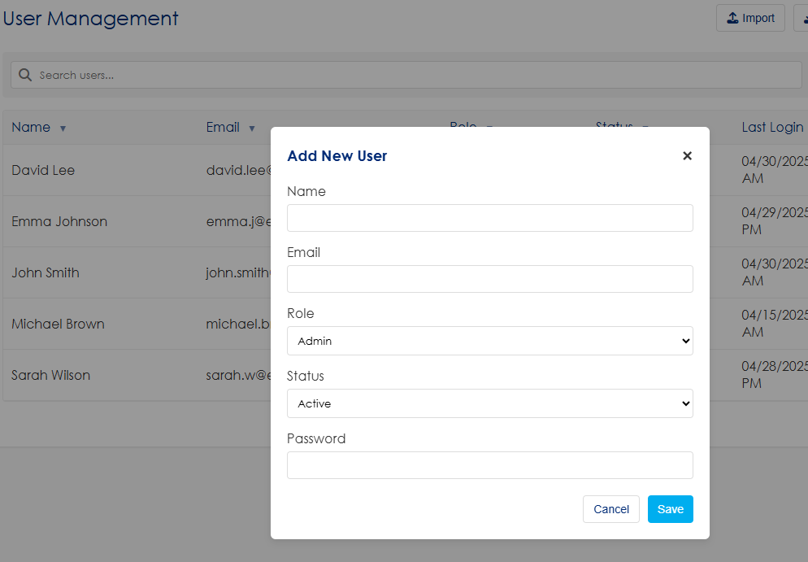
Wireframe Notes – 7.1.1 – Add User
This is the Add User Admin View.
Ability to Add a new User.
Ability to Add another User after adding one.
Ability to Cancel Adding a User.
Ability to assign user roles
Where are we identifying the access they have – by company or partner designation.
This would be used to only show them certs and products related to those.
They also need to have multi-select
Add Company
Review: How is the admin setting this up originally since they are creating.
Do they need to reset after first login? Will admin always see their latest password don’t think that is suggested)
How do you manage user fields by user?
Updates pending
Notes:
Add Company to form
Remove Cancel
Save not submit
This does not address how we would manage what a specific External user could see/their permissions (e.g., only their company certs, etc.), fields they can access, etc.
Assuming having none checked is disabling a user?

Slide 53
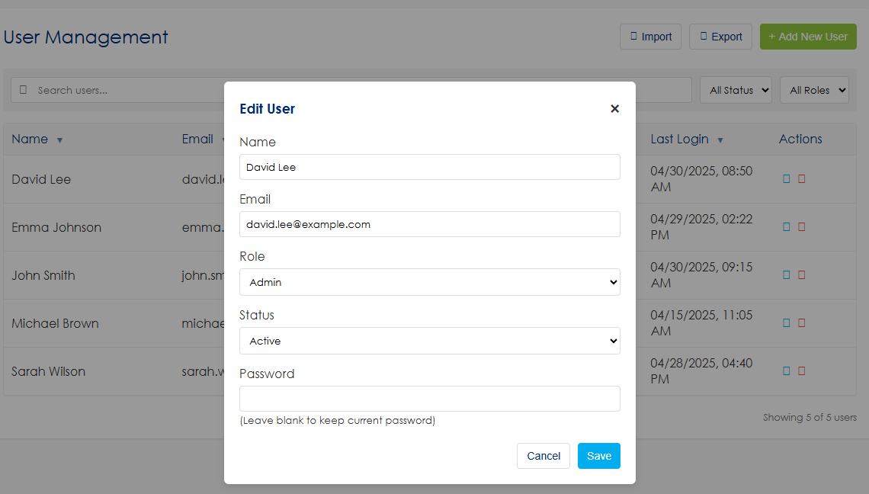
Wireframe Notes – 7.1.2 – Edit/Delete User
This is the Edit User Admin View.
Ability to Edit/Delete a new User.
Ability to Cancel Edit/Delete a User.
Ability to assign user roles
Add Company between Name and Email.
Revise screen for password.
- (leave blank to keep current password)
Updates pending
Notes:
Add Company to form
Remove Cancel
Save not submit
This does not address how we would manage what a specific External user could see/their permissions (e.g., only their company certs, etc.), fields they can access, etc.
Assuming having none checked is disabling a user?

Slide 54
Wireframe Notes – 7.2 – Configuration Settings
Navigation only.

Slide 55
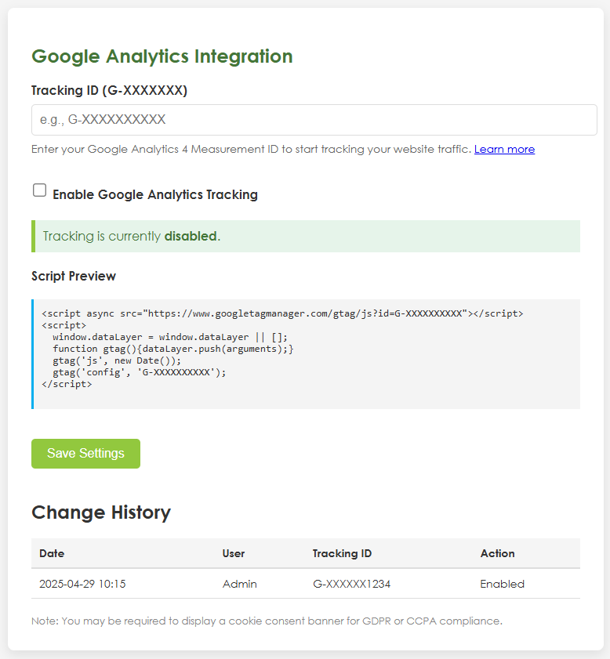
Wireframe Notes – 7.2.2 – Google Analytics
Tracking page. Ability to update Tracking number.
Ability to view change history.
Tacking number should be grey out when disabled.
Updates pending

Slide 56
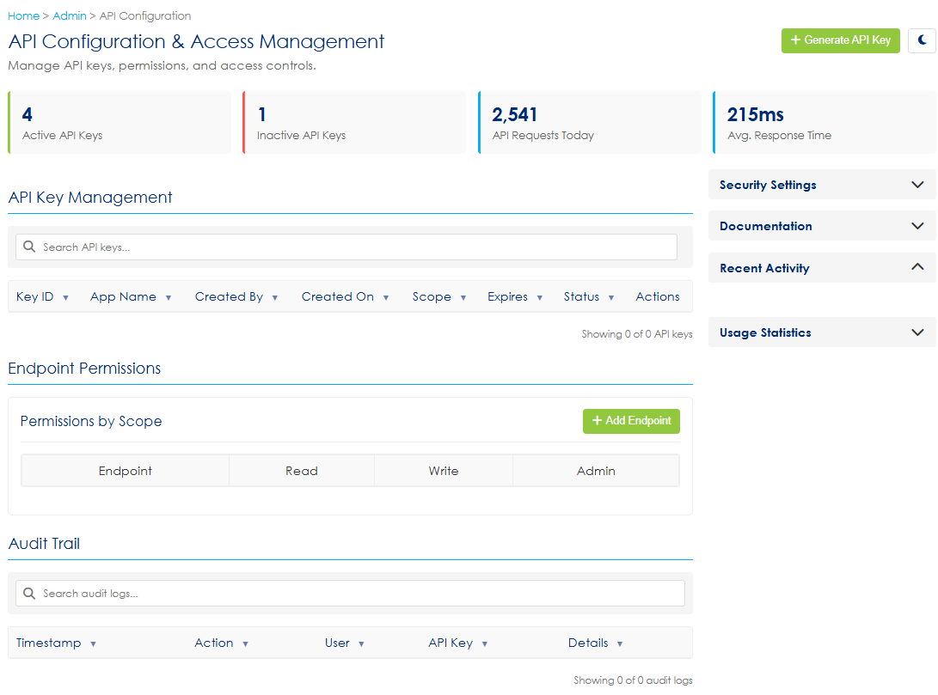
Wireframe Notes – 7.3 – API Management (Draft)
Updates pending
update Screenshot
- No night icon
Per Carly: will rely on Anuki IDK: What type of info would be relevant for a page like this.

Slide 57
Wireframe Notes – 7.3 – Amazon API Integration
Sample JSON to send to Amazon
[
{
"product_name": "EcoSmart LED Bulb",
"product_id_type": “ASIN",
"product_id": "123456789012",
"certification_country": "US",
"certification_agency": "greencircle_energy_savings",
"certification_standard": "",
"certification_value": "",
"certification_end_date": "2025-12-31",
"certification_status": "certified"
},
{
"product_name": "Recycled Office Chair",
"product_id_type": “ASIN",
"product_id": "9876543210987",
"certification_country": "UK",
"certification_agency": "greencircle_recycled_content",
"certification_standard": "",
"certification_value": "",
"certification_end_date": "2024-11-01",
"certification_status": "not certified"
}
]

Slide 58
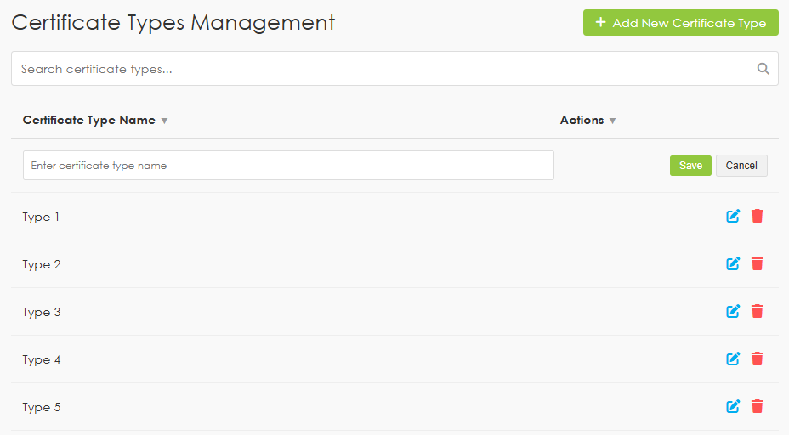
Wireframe Notes – 7.4.1 – Certificate Types
This is the Certificate Types Admin View.
Ability to Add or Edit Certificate Types.
The save row in the screenshot is to show the add view of the data grid. It would only be visible when a user clicks
Update screenshot: Action alignment issue.
Notes:
Save (not submit)

Slide 59
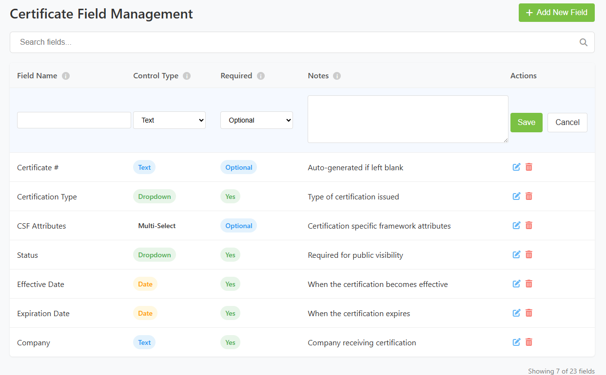
Wireframe Notes – 7.5.1 – Certification Field Management
Updates pending
This is the Certificate Field Management View.
Ability to Add or Edit Certificate Fields.
All edits are inline.
Update screenshot: Action alignment issue.
Definitions for the controls.

Slide 60
Wireframe Notes – 5.2 – Products
Notes:
Ability to manage all Products
Product identifier management for multiple types: ASIN, UPC, GTIN, and EAN
Search functionality to quickly find products
Filtering options by type, status, and partners
Status tracking (Active/Inactive) for each product ID (REVIEW: Will be tied to the status of the associated Certificate # but can be overwritten by selecting a different status under that column. )
Partner association (currently showing Amazon)
Creation date and creator tracking
Import and export capabilities for bulk management
Adding new identifiers with dedicated buttons for each type
Linking multiple identifier types to the same product ID (as shown with PROD-1001 and PROD-1002)
Table view with deletion options for each entry
Notes:
Anuki explore options for: Clone feature that only carries over certain fields like Cert Type, Company, Dates, Location, Country, Company Contact
And potential Excel mass upload
This would be best on a page not a popup given the amount of fields. Would want it to open in new tab when cert is selected for editing.
How are you allowing mass upload of Amazon ASINs (or UPC, GTIN, EAN)? On these pages we need the listing of ASINs/UPC/etc. that are covered under the cert.
Need to be able to copy and paste ASIN (or other) list or upload in bulk.
We need to add other fields specific to the ASIN associated product. I see that list associated with cert in this view at the botto
You need to show how a GCC Analyst will search/add new Company and Product Names
You need to show how available options show for company or product names -- then if there is not one how to add a new (like current DB)
Also, Product selection is editable AFTER company is selected so it will show the associated products from that company already available
You need to show how you add a New Product and tie that product to the right project type -- within this interface/popup not just in the Products page (see current DB)
Product Name is not a required field.
Certificate #: Not accounting for notification that if left blank will auto assign. Unless you are planning some other way to handle this? But this is key functionality for cert numbering.
Company – Move to General Section
Company Contact: These are either URL or an email address (not phone number). Move to General Section
Location and Country: Put this under General because it could be product or facility level cert
Should list Created On and Last Modified (these fields are system generated and not editable)
and what User Last Modiified
Missing a bunch of fields like CSF Attributes, ASIN, UPC, GTIN, EAN
DISCUSS WITH TEAM: For CSF Attributes: If a specific attribute from the dropdown is selected than that cert would appear in the public search for that cert type. For example if the CSF has Recycled Content, then the CSF would appear when selecting Recycled Content
Tags should be color coded for internal vs external
Need ability to upload certificate file and preview button
Change Submit to Save

Slide 61
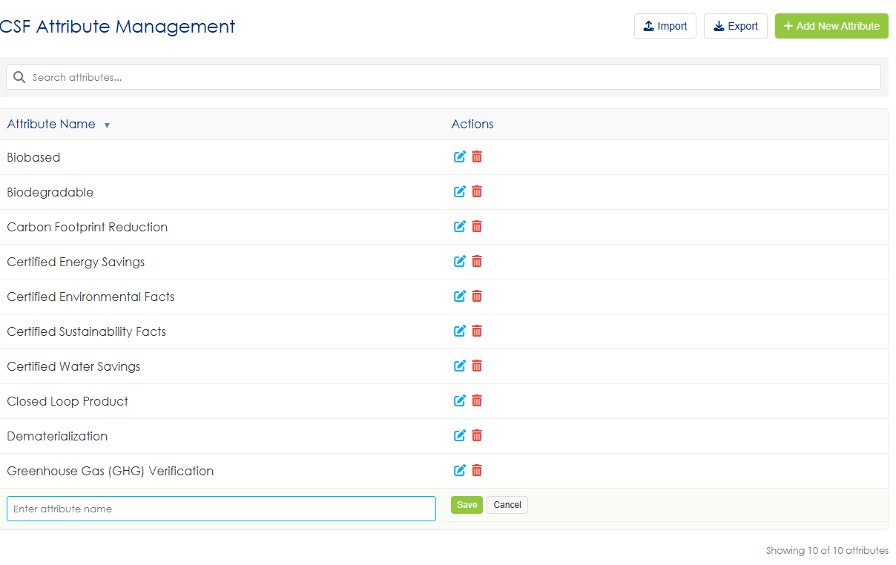
Wireframe Notes – 7.5.2 – CSF Attributes
Updates pending
This is the CSF Attributes View.
Only Admins can edit this page.
Ability to Add CSF Attributes
Ability to Edit/Delete Selected CSF Attributes.
Should not need to import for this. Remove
Do we need this if you it inline below.
Should add buttons on this screen and all screens to integrated into the grid?
Notes:
Delete button should have a popup.
Apply applicable comments from page 48
Can we color code internal vs external tags.
Ability to sort by alphabetical order

Slide 62
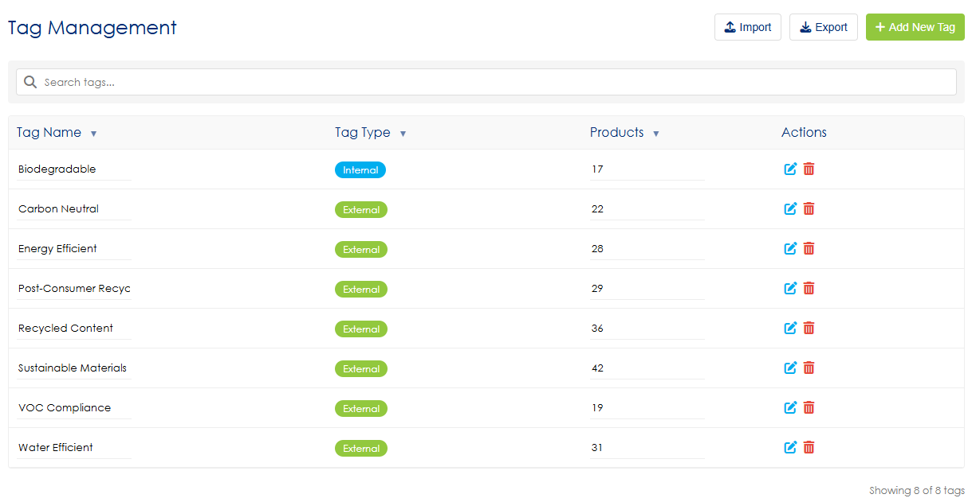
Wireframe Notes – 7.5.3 – Tags
This is the Tags Admin View.
Ability to Add, Edit/Delete Selected Tags.
Ability to sort, export tags.
Notes:
Delete button should have a popup.
Apply applicable comments from page 48
Can we color code internal vs external tags.
Ability to sort by alphabetical order

Slide 63
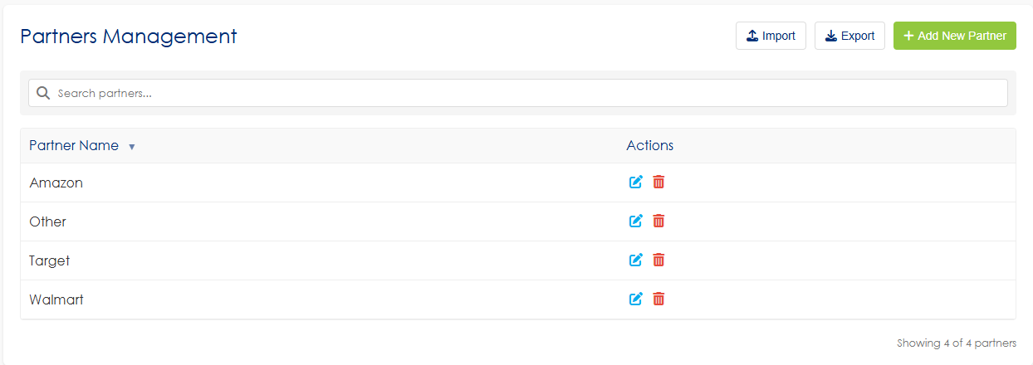
Wireframe Notes – 7.5.4 – Partners
This is the Partners Admin View.
Ability to Add new Partners.
Ability to Edit/Delete Selected Partners.
Ability to sort, export tags.
Notes:
Delete button should have a popup.
Apply applicable comments from page 48
Can we color code internal vs external tags.
Ability to sort by alphabetical order

Slide 64
Out of Scope

Slide 65
Out of Scope – Initial Design Phase
The following items are not included in the initial scope of design and implementation:
Notifications & Alerts
  The system will not deliver notifications or real-time updates to users during this phase.
Undocumented Features
  Any user stories or functional requirements not explicitly captured in this document or its supporting requirement documents are out of scope.
Clone Feature Enhancements
  The "Clone" functionality — including selective field carry-over (e.g., Certification Type, Company, Dates, Location, Country, Company Contact) — will not be implemented in this phase.
Bulk Upload for Product Identifiers
  Bulk upload capabilities (e.g., ASIN, UPC, GTIN, EAN) file upload will not be available. The current scope excludes any listing or association management of product identifiers under certifications.
Product-Specific Fields
  Additional data fields specific to products associated with ASINs (or similar identifiers) will not be included, though they may be shown in wireframes for planning purposes.
Customized Reporting Widgets
  Customizable dashboard widgets, including the ability for external users to view data specific to their profiles or needs, are out of scope.
Third-Party API Integrations
  Integrations with third-party vendors or clients beyond those explicitly defined are excluded from the initial scope.
Updates pending
*Note: This will be amended, based on any changes to the requirements.
Notes:
S6:
Wishlist items: What is the list of items included but not part of Phase 1? Not sure I would be clear on what is excluded and need to make sure it is nothing critical.
TODO: provide list of what is in Phase 1 and what is not included in Phase 1.

